Slide 1

FAULT DETECTION IN MULTI-INPUT ANALOG CIRCUITS USING POLYNOMIAL REGRESSION MODELLING
Presented by
Simran Gupta
Research Intern(25SR0031)
B.Tech (ECE)
NIT JAMSHEDPUR
Under the Guidance of
Dr. Rahul Bhattacharya
Dept. of Electronics Engineering
IIT (ISM) Dhanbad

Slide 2
OBJECTIVE
To detect faults in multi-input analog circuits using polynomial regression models.
Polynomial modelling for both linear and nonlinear circuits.
Fault detection under DC sweep and sine wave inputs
Analysis of single and multiple faults, noise robustness.

Slide 3
Literature Survey
Citation | Literature | Purpose | Method Used | Research Gap
S. Sindia, V. D. Agrawal, and V. Singh [1] | 29th VLSI Test Symposium, 2011 | Non-linear analog circuit test using V-transform | Polynomial coefficients made monotonic using V-transform | Fails to handle multiple faults or noise-influenced variation
S. Sindia and V. D. Agrawal [2] | ITC Conference, 2013 | High-sensitivity test signatures for analog circuits | Needs little circuit augmentation | Considers only one fault at a time
Piotr Bilski [3] | Measurement, vol. 160, 2020 | Ensemble regression for parametric identification | Uses regression ensembles to analyze faults | Not tested on heterogeneous architectures
Zhao & Yuzhu He [4] | J. of Electronic Testing, 2015 | Test point selection method | Fault ambiguity minimized using optimization | Ignores circuits with undefined inputs
Alkis A. Hatzopoulos [5] | IMSTW 2017 | Current spectrum-based analog test | Uses wavelet transforms and supply current | Intermittent faults remain undetected
H. Kobayashi et al. [6] | ICSICT 2020 | Op-amp and ADC testing techniques | Combines DC-AC, null, and input generators | Not versatile for all circuit types
Riewruja & Rerkratn [7] | Int. J. of Electronics, 2011 | Design of low-cost analog multiplier using op-amps | Uses quarter-square technique with class AB op-amps | No regression-based testing or noise/fault sensitivity analysis provided

Slide 4
WHY THIS METHOD?
For Testing Analog Circuits
Specification based test methodology
Advantage of new approach[1] :
Enhances coefficient sensitivity.
Improved fault diagnosis without circuit augmentation.
Increased fault coverage.
Low defect level & yield loss.
Suffers from high test cost
Signature based testing using polynomial expansion
Fault Model based test
To alleviate testing cost problem
Taylor Coefficients as Test Signatures
Using :
OrCAD (for fault injection)
MATLAB (o/p function is expanded & modified for testing)
Alternate test
Due to :
Lack of confidence in defect level & yield loss.
Unavailability of output that are sufficiently sensitive to circuit components.
Limited industry acceptance

Slide 5

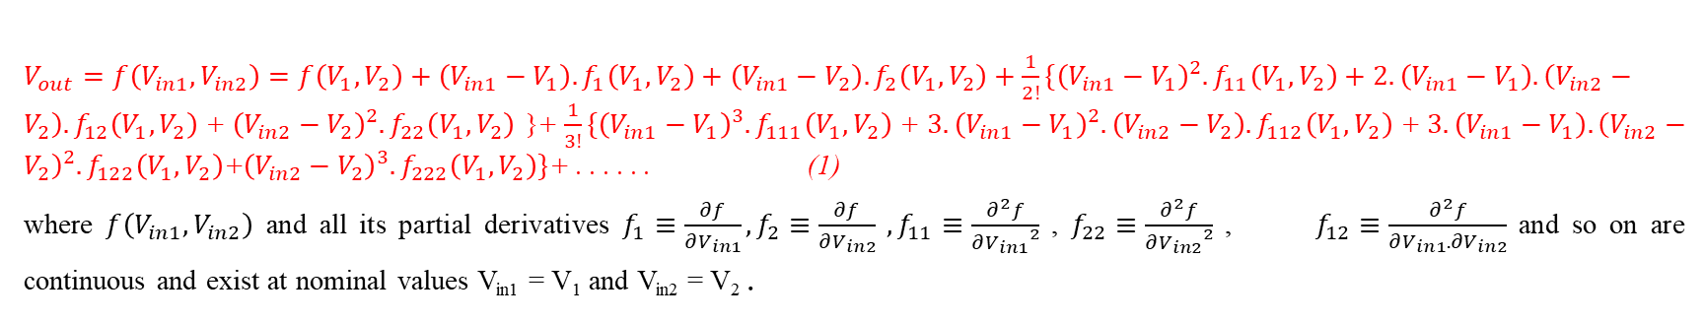
POLYNOMIAL REGRESSION MODELLING
Polynomial regression is a form of linear regression where the relationship between input variables and output is modeled as an nth-degree polynomial.
It approximates the output Vout​ of an Analog circuit as a Taylor series expansion around nominal input values Vin1=V1 and Vin2=V2.
$V_{out}=f\left(V_{in1},V_{in2}\right)=f\left(V_{1},V_{2}\right)+{\left(V_{in1}−V_{1}\right).f}_{1}\left(V_{1},V_{2}\right)+{\left(V_{in1}−V_{2}\right).f}_{2}\left(V_{1},V_{2}\right)+\frac{1}{2!}\{{\left(V_{in1}−V_{1}\right)}^{2}.f_{11}\left(V_{1},V_{2}\right)+2.\left(V_{in1}−V_{1}\right).\left(V_{in2}−V_{2}\right).f_{12}\left(V_{1},V_{2}\right)$+${\left(V_{in2}−V_{2}\right)}^{2}.f_{22}\left(V_{1},V_{2}\right)$}+$\frac{1}{3!}\{{\left(V_{in1}−V_{1}\right)}^{3}.f_{111}\left(V_{1},V_{2}\right)$+$3.{\left(V_{in1}−V_{1}\right)}^{2}.\left(V_{in2}−V_{2}\right).f_{112}\left(V_{1},V_{2}\right)$+$3.\left(V_{in1}−V_{1}\right).{\left(V_{in2}−V_{2}\right)}^{2}.f_{122}\left(V_{1},V_{2}\right)$+${\left(V_{in2}−V_{2}\right)}^{3}.f_{222}\left(V_{1},V_{2}\right)\}$+ . . . . . . (1)
where $f\left(V_{in1},V_{in2}\right)$ and all its partial derivatives $f_{1}≡\frac{∂f}{∂V_{in1}}, f_{2}≡\frac{∂f}{∂V_{in2}} , f_{11}≡\frac{∂^{2}f}{{∂V_{in1}}^{2}}$ , $f_{22}≡\frac{∂^{2}f}{{∂V_{in2}}^{2}}$ , $f_{12}≡\frac{∂^{2}f}{∂V_{in1}. ∂V_{in2}}$ and so on are continuous and exist at nominal values V_{in1} = V₁ and V_{in2} = V₂ .
Coefficients ai​ are estimated using least squares fitting (e.g., MATLAB’s Polyfitn ).
Eqn. (1) can be further approximated as
$V_{out}=f\left(V_{in1},V_{in2}\right)={a_{0}V_{in1}}^{m}+{a_{1}V_{in1}}^{m−1}V_{in2}+{a_{2}V_{in1}}^{m−1}+{a_{3}V_{in1}}^{m−2}{V_{in2}}^{2}+$………+ℇ (3)
The number of coefficients for an m^{th} degree polynomial regression model which can estimate the output of a two-input CUT can be given as
N_{coeff} $=\frac{(m+1)(m+2)}{2}$

Slide 6
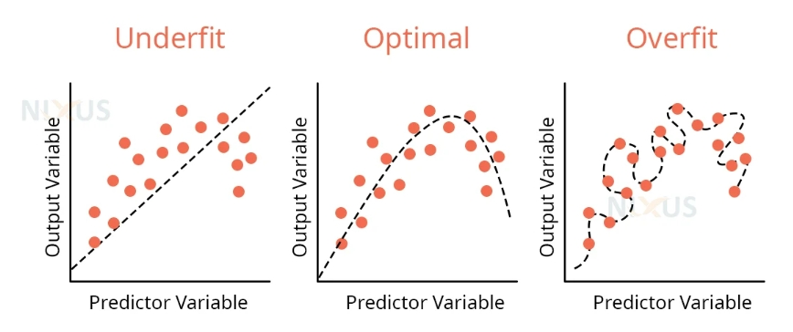
OPTIMAL ORDER
Selecting the right polynomial degree (order) is crucial to avoid underfitting or overfitting in regression-based fault modeling.
AIC/BIC provides an automated, principled, and efficient method for selecting the best polynomial order in regression-based fault modeling — without overfitting, thresholds, or guesswork.
AIC = n · ln(MSE) + 2 · k BIC = n · ln(MSE) + k · ln(n)
Where: n = Number of data points. k = Number of parameters (Polynomial order ). MSE = Mean Squared Error.
AIC/BIC minimizes overfitting by balancing model complexity and error.
This ensures optimal polynomial order for reliable fault detection in analog circuits.

Slide 7
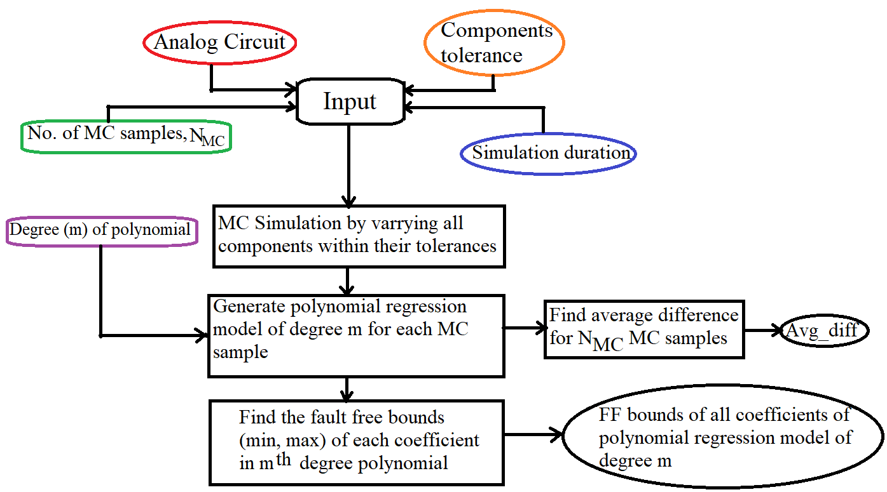
Flow chart for computation of fault free coefficient bounds
Optimal order using AIC/BIC

Slide 8
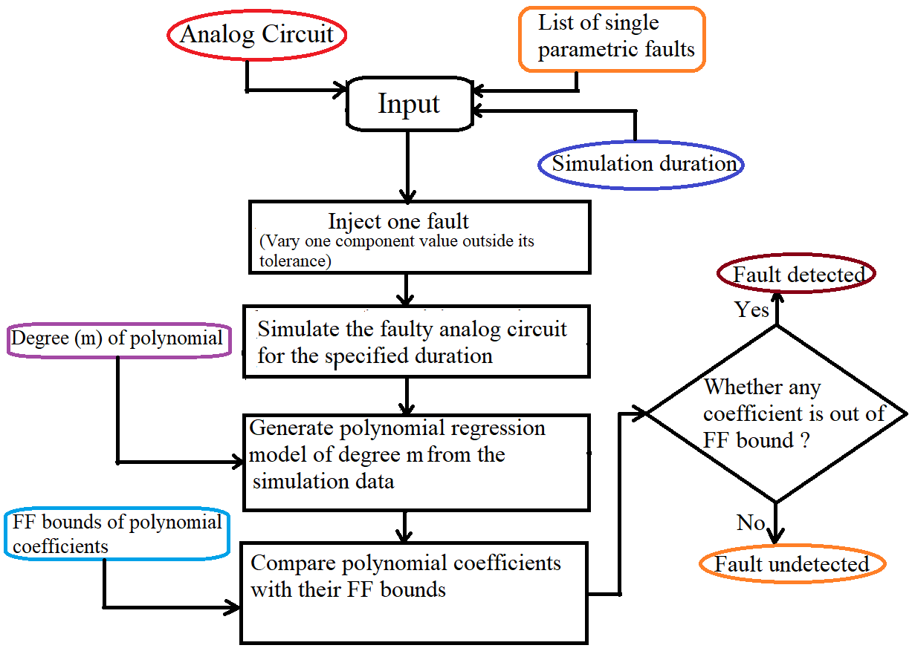
Flowchart for finding faulty component
Optimal order using AIC/BIC

Slide 9

CIRCUITS UNDER STUDY
LINEAR CIRCUIT
Lead-lag Circuit with sine input
PI Compensator of a Buck Converter
NON-LINEAR CIRCUIT
Analog multiplier with sine input
Analog Multiplier with DC sweep input varied at the rate of 50 Hz and 100Hz frequency
Lead-lag circuit with DC sweep input varied at rate of 50 Hz & 100Hz frequency

Slide 10
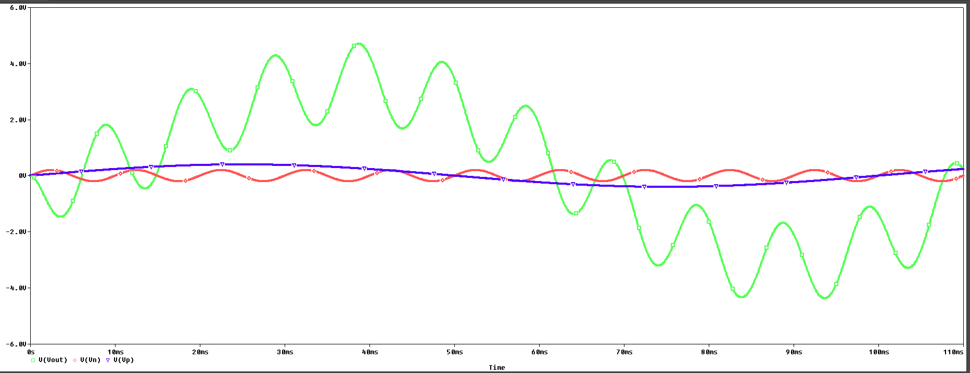
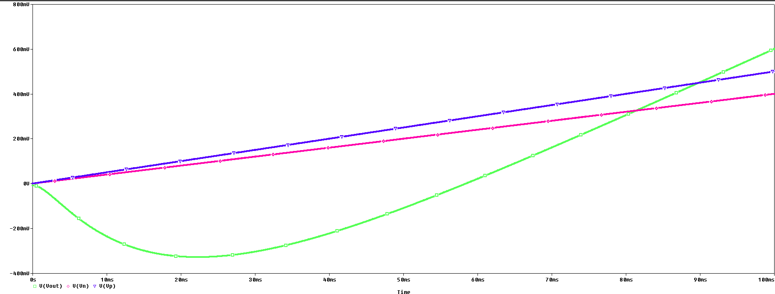
Case Study-1: Lead-lag Circuit
A 100 Hz sinusoidal signal at 200 mV amplitude is applied at the inverting input, while a 10 Hz sinusoidal signal at 400 mV amplitude is applied at the non-inverting input.
A DC sweep input at the rate of 100 Hz from 0V to 0.4V is applied at the inverting input, while a DC sweep input at the rate of 50 Hz from 0V to 0.5V is applied at the non-inverting input.
Fig. - Lead-lag circuit with two low-pass filters
The nominal values of the circuit components of the lead-lag circuit shown in Fig. 3 are- R1=1kΩ, R2= 10kΩ, R3=10kΩ, C1=0.1595μF, C2=1.595μF
Response of lead-lag circuit simulated with sine input in Orcade
Response of lead-lag circuit simulated with dc sweep input in Orcade

Slide 11

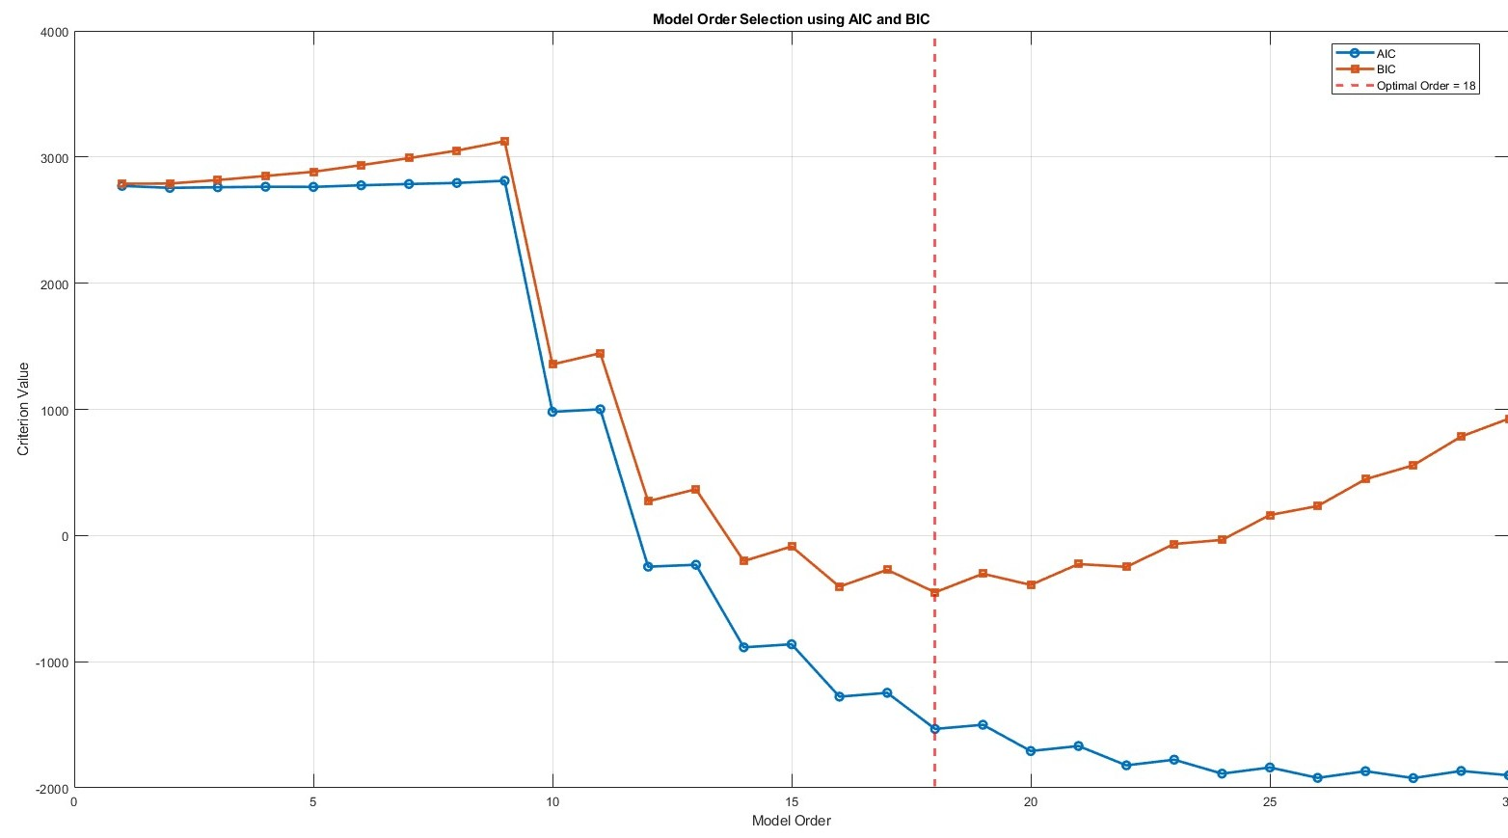
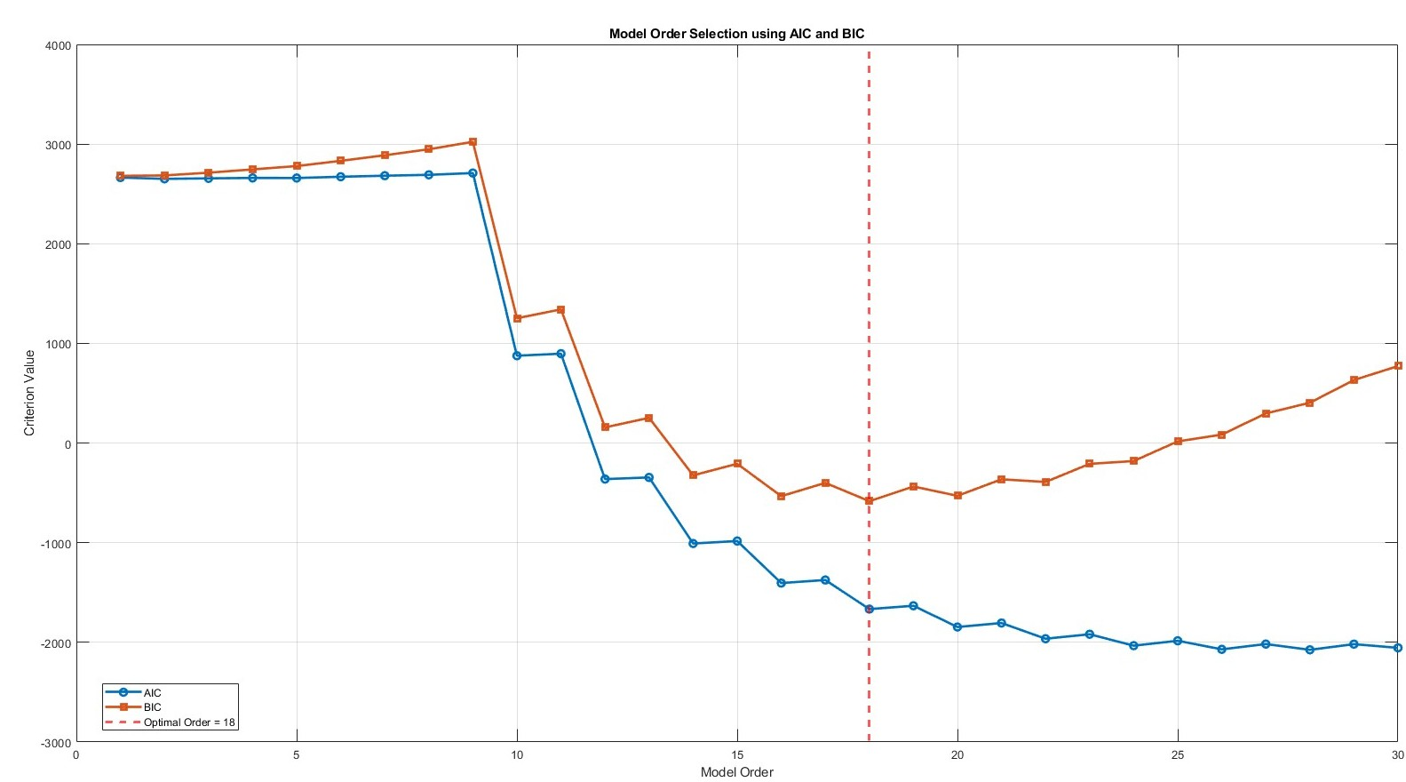
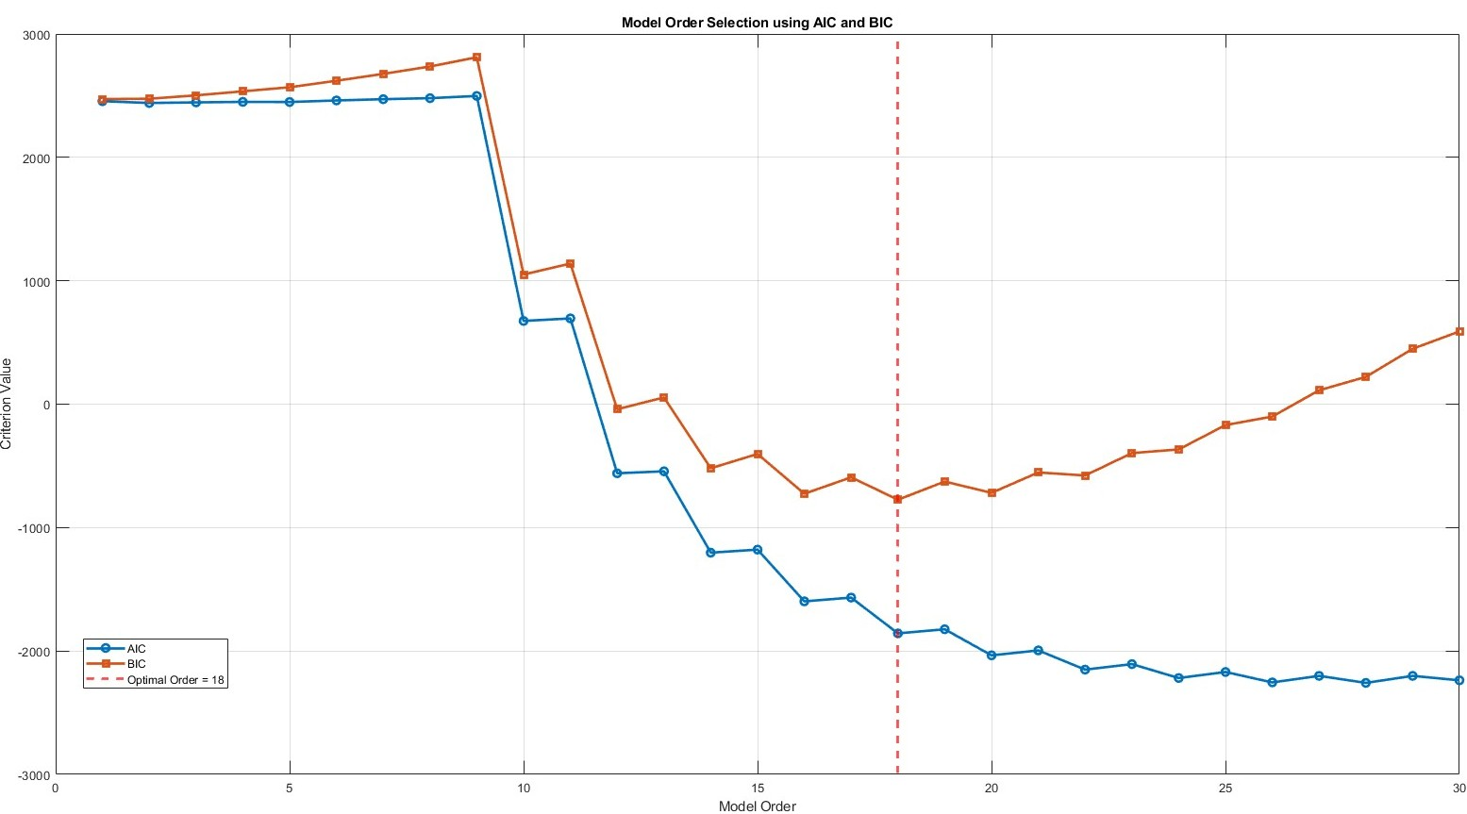
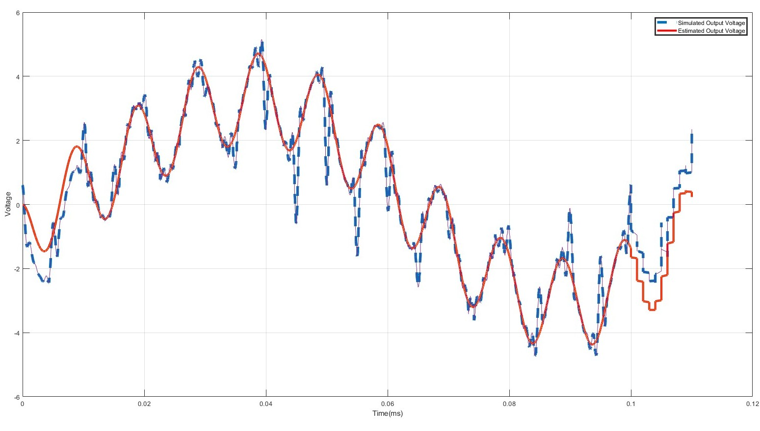
Illustration-1 : Lead-lag Circuit with sine input
Determination of optimal Order
Optimal order plot at Nmc=1000
Optimal order plot at Nmc=2000
Optimal order plot at Nmc=500
Simulated Output VS regression model Output

Slide 12
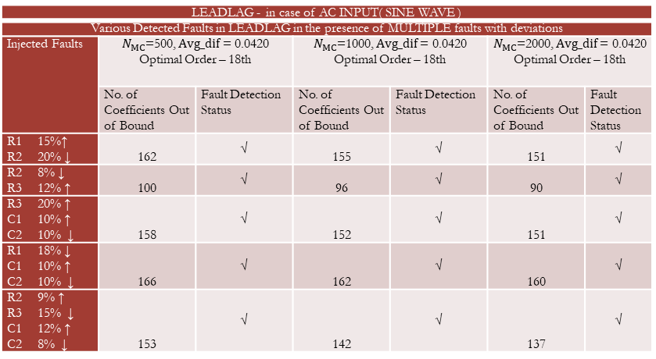
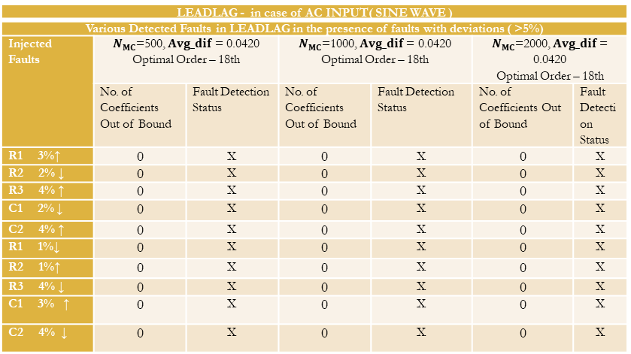
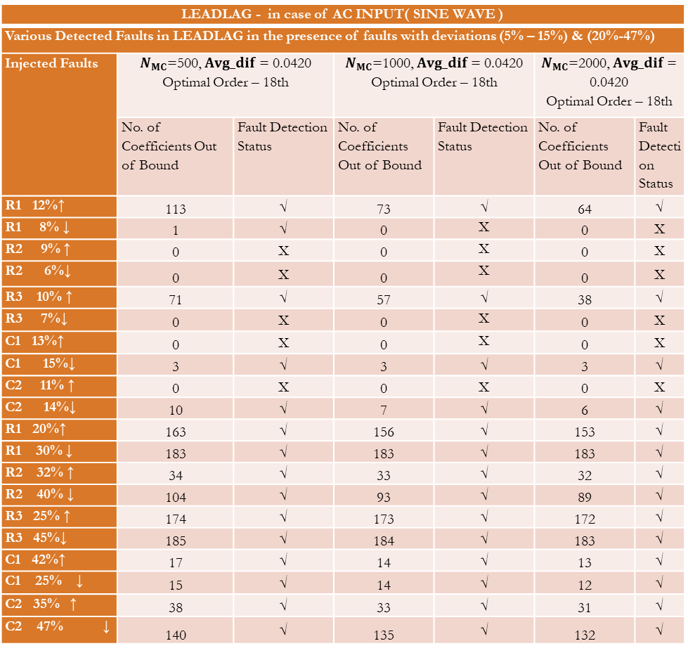
RESULT
LEADLAG - in case of AC INPUT( SINE WAVE )
Various Detected Faults in LEADLAG in the presence of faults with deviations (5% – 15%) & (20%-47%)
Injected Faults | $N_{MC}$=500, $Avg_dif$ = 0.0420 Optimal Order – 18th |  | $N_{MC}$=1000, $Avg_dif$ = 0.0420 Optimal Order – 18th |  | $N_{MC}$=2000, $Avg_dif$ = 0.0420 Optimal Order – 18th
 | No. of Coefficients Out of Bound | Fault Detection Status | No. of Coefficients Out of Bound | Fault Detection Status | No. of Coefficients Out of Bound | Fault Detection Status
R1 12%↑ | 113 | √ | 73 | √ | 64 | √
R1 8% ↓ | 1 | √ | 0 | X | 0 | X
R2 9% ↑ | 0 | X | 0 | X | 0 | X
R2 6%↓ | 0 | X | 0 | X | 0 | X
R3 10% ↑ | 71 | √ | 57 | √ | 38 | √
R3 7%↓ | 0 | X | 0 | X | 0 | X
C1 13%↑ | 0 | X | 0 | X | 0 | X
C1 15%↓ | 3 | √ | 3 | √ | 3 | √
C2 11% ↑ | 0 | X | 0 | X | 0 | X
C2 14%↓ | 10 | √ | 7 | √ | 6 | √
R1 20%↑ | 163 | √ | 156 | √ | 153 | √
R1 30% ↓ | 183 | √ | 183 | √ | 183 | √
R2 32% ↑ | 34 | √ | 33 | √ | 32 | √
R2 40% ↓ | 104 | √ | 93 | √ | 89 | √
R3 25% ↑ | 174 | √ | 173 | √ | 172 | √
R3 45%↓ | 185 | √ | 184 | √ | 183 | √
C1 42%↑ | 17 | √ | 14 | √ | 13 | √
C1 25% ↓ | 15 | √ | 14 | √ | 12 | √
C2 35% ↑ | 38 | √ | 33 | √ | 31 | √
C2 47% ↓ | 140 | √ | 135 | √ | 132 | √
LEADLAG - in case of AC INPUT( SINE WAVE )
Various Detected Faults in LEADLAG in the presence of faults with deviations ( >5%)
Injected Faults | $N_{MC}$=500, $Avg_dif$ = 0.0420 Optimal Order – 18th |  | $N_{MC}$=1000, $Avg_dif$ = 0.0420 Optimal Order – 18th |  | $N_{MC}$=2000, $Avg_dif$ = 0.0420 Optimal Order – 18th
 | No. of Coefficients Out of Bound | Fault Detection Status | No. of Coefficients Out of Bound | Fault Detection Status | No. of Coefficients Out of Bound | Fault Detection Status
R1 3%↑ | 0 | X | 0 | X | 0 | X
R2 2% ↓ | 0 | X | 0 | X | 0 | X
R3 4% ↑ | 0 | X | 0 | X | 0 | X
C1 2% ↓ | 0 | X | 0 | X | 0 | X
C2 4% ↑ | 0 | X | 0 | X | 0 | X
R1 1%↓ | 0 | X | 0 | X | 0 | X
R2 1%↑ | 0 | X | 0 | X | 0 | X
R3 4% ↓ | 0 | X | 0 | X | 0 | X
C1 3% ↑ | 0 | X | 0 | X | 0 | X
C2 4% ↓ | 0 | X | 0 | X | 0 | X
LEADLAG - in case of AC INPUT( SINE WAVE )
Various Detected Faults in LEADLAG in the presence of MULTIPLE faults with deviations
Injected Faults | $N_{MC}$=500, $Avg_dif$ = 0.0420 Optimal Order – 18th |  | $N_{MC}$=1000, $Avg_dif$ = 0.0420 Optimal Order – 18th |  | $N_{MC}$=2000, $Avg_dif$ = 0.0420 Optimal Order – 18th
 | No. of Coefficients Out of Bound | Fault Detection Status | No. of Coefficients Out of Bound | Fault Detection Status | No. of Coefficients Out of Bound | Fault Detection Status
R1 15%↑ R2 20% ↓ | 162 | √ | 155 | √ | 151 | √
R2 8% ↓ R3 12% ↑ | 100 | √ | 96 | √ | 90 | √
R3 20% ↑ C1 10% ↑ C2 10% ↓ | 158 | √ | 152 | √ | 151 | √
R1 18% ↓ C1 10% ↑ C2 10% ↓ | 166 | √ | 162 | √ | 160 | √
R2 9% ↑ R3 15% ↓ C1 12% ↑ C2 8% ↓ | 153 | √ | 142 | √ | 137 | √

Slide 13
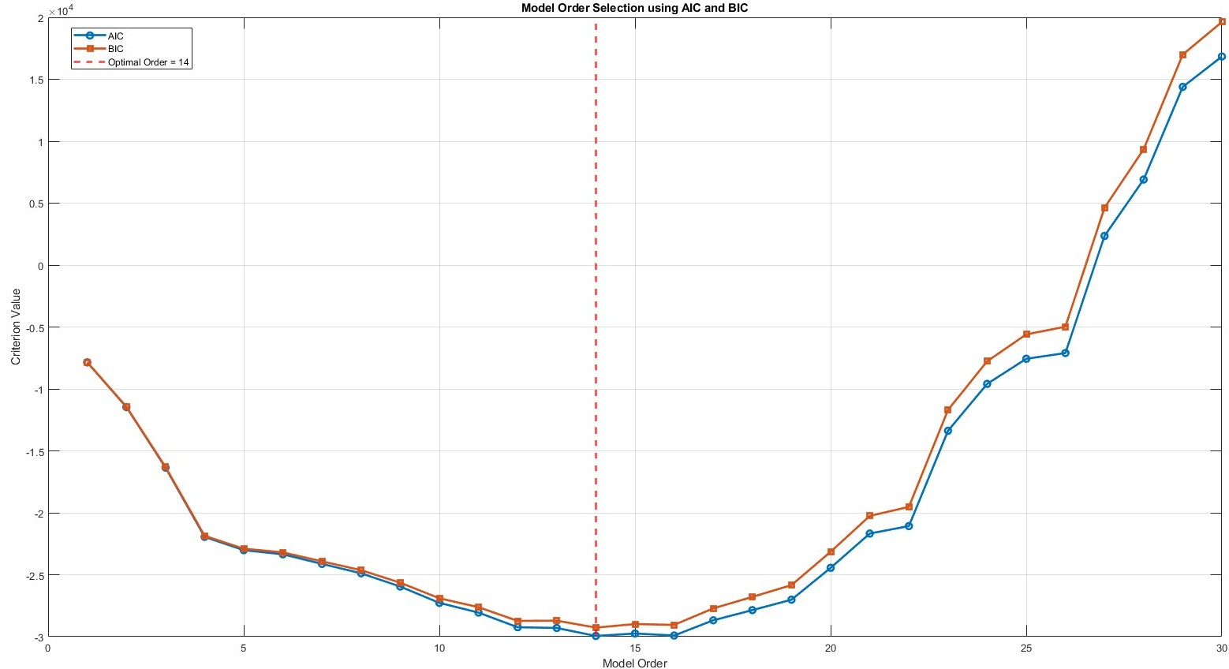
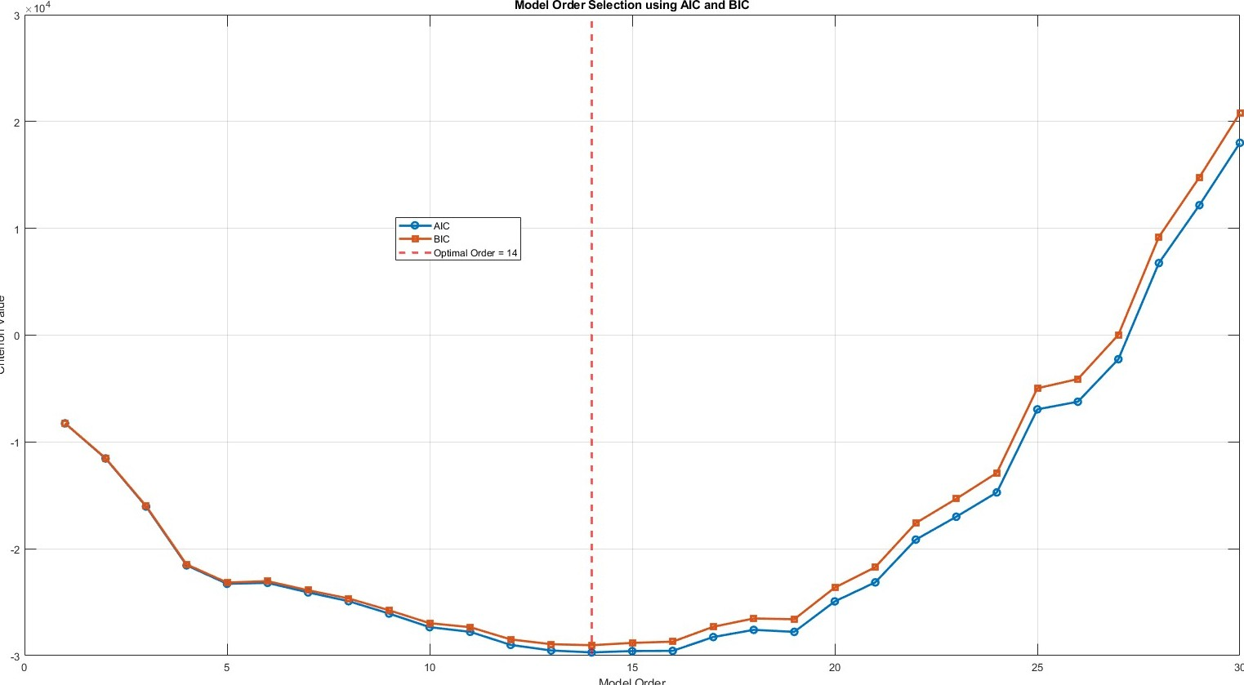
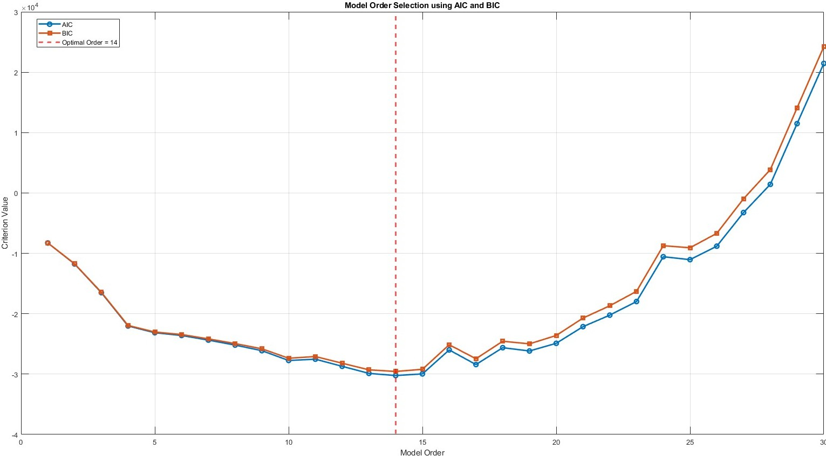
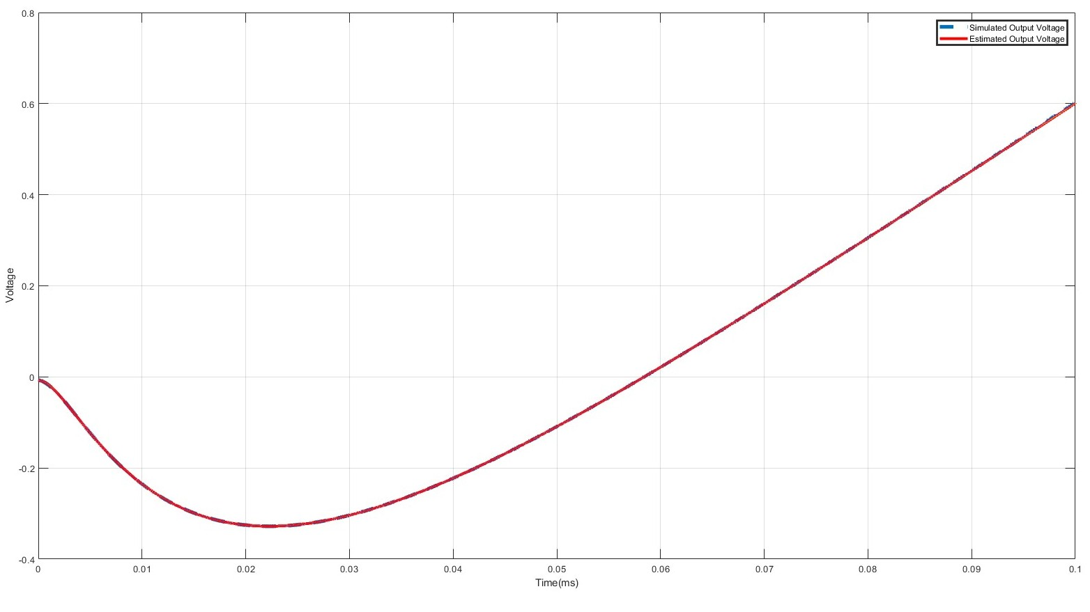
Illustration-2 : Lead-lag Circuit with DC sweep input
Determination of optimal Order
Optimal order plot at Nmc=1000
Optimal order plot at Nmc=2000
Optimal order plot at Nmc=500
Simulated Output VS regression model Output

Slide 14
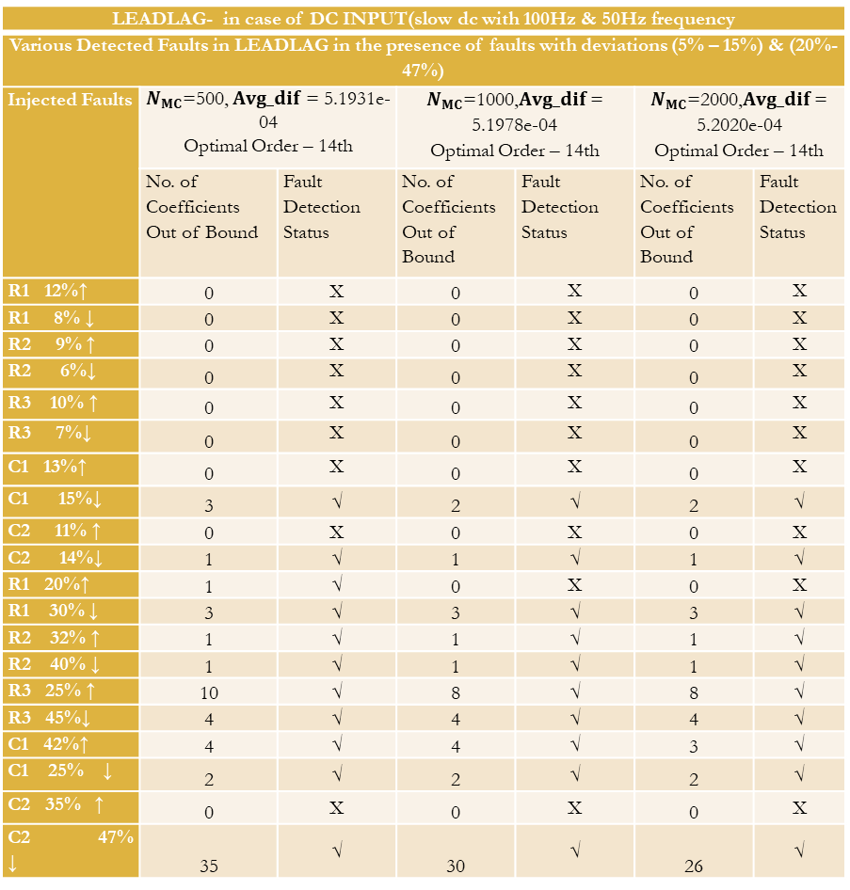
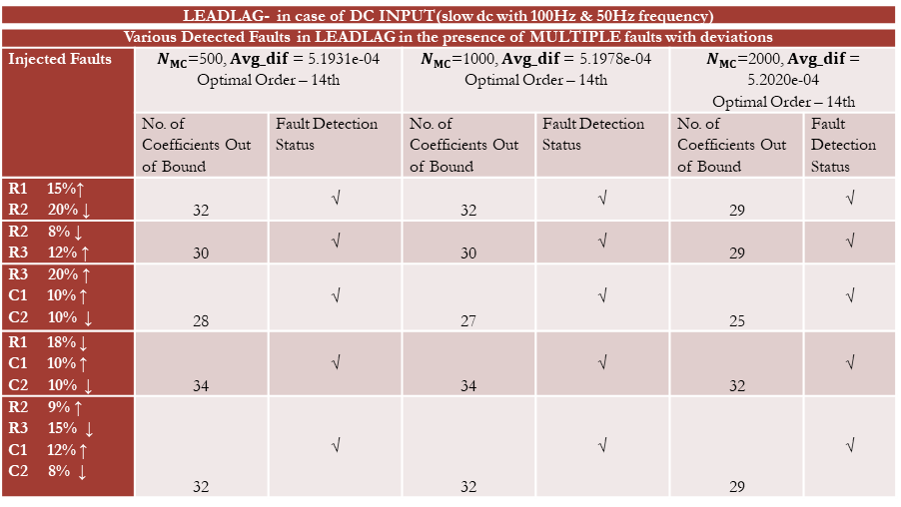
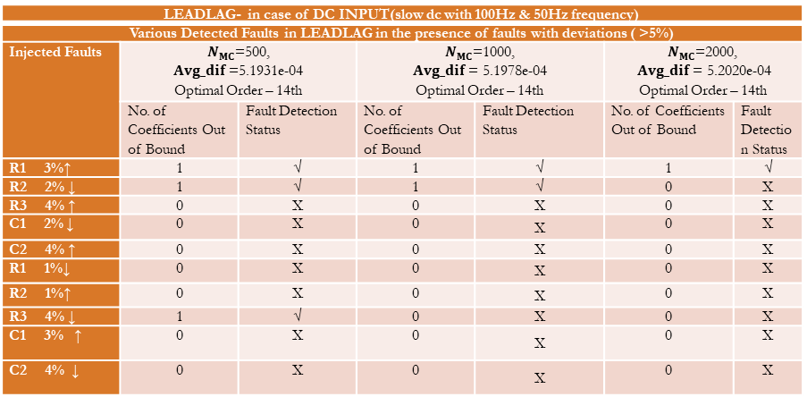
RESULT
LEADLAG- in case of DC INPUT(slow dc with 100Hz & 50Hz frequency
Various Detected Faults in LEADLAG in the presence of faults with deviations (5% – 15%) & (20%-47%)
Injected Faults | $N_{MC}$=500, $Avg_dif$ = 5.1931e-04 Optimal Order – 14th |  | $N_{MC}$=1000,$Avg_dif$ = 5.1978e-04 Optimal Order – 14th |  | $N_{MC}$=2000,$Avg_dif$ = 5.2020e-04 Optimal Order – 14th
 | No. of Coefficients Out of Bound | Fault Detection Status | No. of Coefficients Out of Bound | Fault Detection Status | No. of Coefficients Out of Bound | Fault Detection Status
R1 12%↑ | 0 | X | 0 | X | 0 | X
R1 8% ↓ | 0 | X | 0 | X | 0 | X
R2 9% ↑ | 0 | X | 0 | X | 0 | X
R2 6%↓ | 0 | X | 0 | X | 0 | X
R3 10% ↑ | 0 | X | 0 | X | 0 | X
R3 7%↓ | 0 | X | 0 | X | 0 | X
C1 13%↑ | 0 | X | 0 | X | 0 | X
C1 15%↓ | 3 | √ | 2 | √ | 2 | √
C2 11% ↑ | 0 | X | 0 | X | 0 | X
C2 14%↓ | 1 | √ | 1 | √ | 1 | √
R1 20%↑ | 1 | √ | 0 | X | 0 | X
R1 30% ↓ | 3 | √ | 3 | √ | 3 | √
R2 32% ↑ | 1 | √ | 1 | √ | 1 | √
R2 40% ↓ | 1 | √ | 1 | √ | 1 | √
R3 25% ↑ | 10 | √ | 8 | √ | 8 | √
R3 45%↓ | 4 | √ | 4 | √ | 4 | √
C1 42%↑ | 4 | √ | 4 | √ | 3 | √
C1 25% ↓ | 2 | √ | 2 | √ | 2 | √
C2 35% ↑ | 0 | X | 0 | X | 0 | X
C2 47% ↓ | 35 | √ | 30 | √ | 26 | √
LEADLAG- in case of DC INPUT(slow dc with 100Hz & 50Hz frequency)
Various Detected Faults in LEADLAG in the presence of faults with deviations ( >5%)
Injected Faults | $N_{MC}$=500, $Avg_dif$ =5.1931e-04 Optimal Order – 14th |  | $N_{MC}$=1000, $Avg_dif$ = 5.1978e-04 Optimal Order – 14th |  | $N_{MC}$=2000, $Avg_dif$ = 5.2020e-04 Optimal Order – 14th
 | No. of Coefficients Out of Bound | Fault Detection Status | No. of Coefficients Out of Bound | Fault Detection Status | No. of Coefficients Out of Bound | Fault Detection Status
R1 3%↑ | 1 | √ | 1 | √ | 1 | √
R2 2% ↓ | 1 | √ | 1 | √ | 0 | X
R3 4% ↑ | 0 | X | 0 | X | 0 | X
C1 2% ↓ | 0 | X | 0 | X | 0 | X
C2 4% ↑ | 0 | X | 0 | X | 0 | X
R1 1%↓ | 0 | X | 0 | X | 0 | X
R2 1%↑ | 0 | X | 0 | X | 0 | X
R3 4% ↓ | 1 | √ | 0 | X | 0 | X
C1 3% ↑ | 0 | X | 0 | X | 0 | X
C2 4% ↓ | 0 | X | 0 | X | 0 | X
LEADLAG- in case of DC INPUT(slow dc with 100Hz & 50Hz frequency)
Various Detected Faults in LEADLAG in the presence of MULTIPLE faults with deviations
Injected Faults | $N_{MC}$=500, $Avg_dif$ = 5.1931e-04 Optimal Order – 14th |  | $N_{MC}$=1000, $Avg_dif$ = 5.1978e-04 Optimal Order – 14th |  | $N_{MC}$=2000, $Avg_dif$ = 5.2020e-04 Optimal Order – 14th
 | No. of Coefficients Out of Bound | Fault Detection Status | No. of Coefficients Out of Bound | Fault Detection Status | No. of Coefficients Out of Bound | Fault Detection Status
R1 15%↑ R2 20% ↓ | 32 | √ | 32 | √ | 29 | √
R2 8% ↓ R3 12% ↑ | 30 | √ | 30 | √ | 29 | √
R3 20% ↑ C1 10% ↑ C2 10% ↓ | 28 | √ | 27 | √ | 25 | √
R1 18% ↓ C1 10% ↑ C2 10% ↓ | 34 | √ | 34 | √ | 32 | √
R2 9% ↑ R3 15% ↓ C1 12% ↑ C2 8% ↓ | 32 | √ | 32 | √ | 29 | √

Slide 15
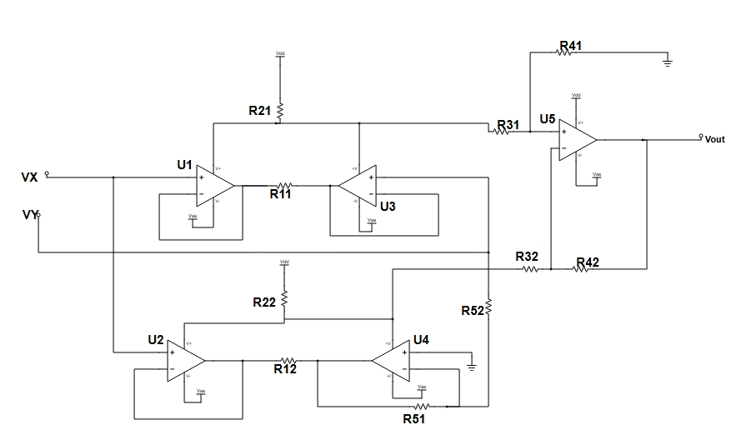
Case Study-2: Analog Multiplier Circuit
⚙️ Key Features of the Proposed Analog Multiplier:
Utilizes translinear characteristic of the class-AB output stage of op-amps.
Employs op-amp supply current sensing technique to obtain:
Square of sum and Square of difference of two input signals.
vo = (1/4) × [ (v1 + v2)² – (v1 – v2)² ] = v1 × v2
Multiplication performed using quarter-square algebraic identity.
Achieves low-voltage operation with general-purpose op-amps.
Implements a four-quadrant analog multiplier using only op-amps (no extra active devices).
The nominal component values used in the simulation are:
R11=R12 = 10 kΩ,R21=R22=1 kΩ,R31 =R32= 250 kΩ,R41 =R42= 500 kΩ, R51 = R52=250 kΩ
Fig:- Four Quadrant Analog Multiplier using op-amp

Slide 16
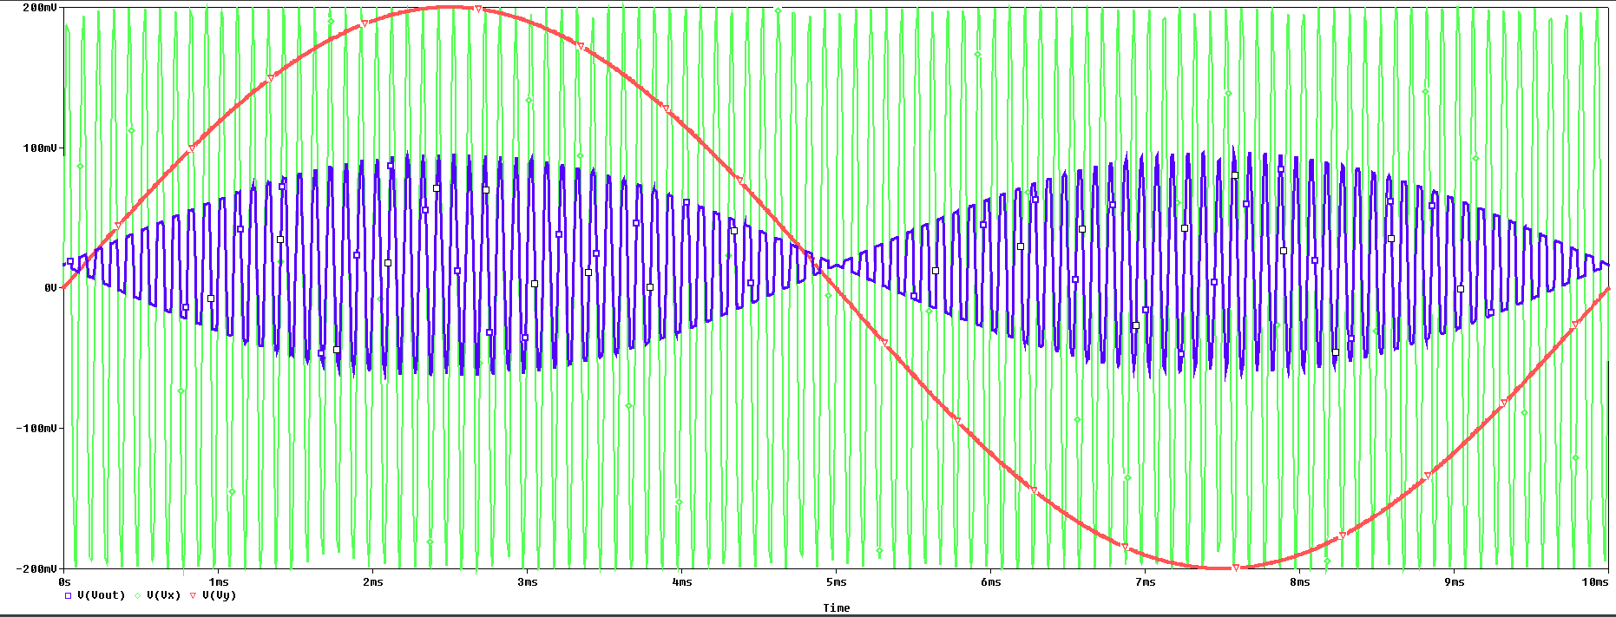
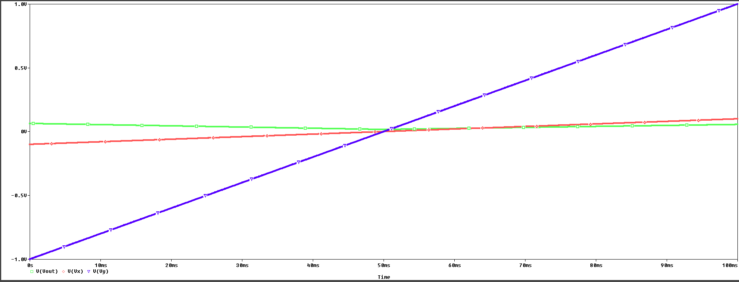
Case Study-2: Analog Multiplier Circuit
Fig:-Response of multiplier with sine input
Fig:-Response of multiplier with slowDC input

Slide 17
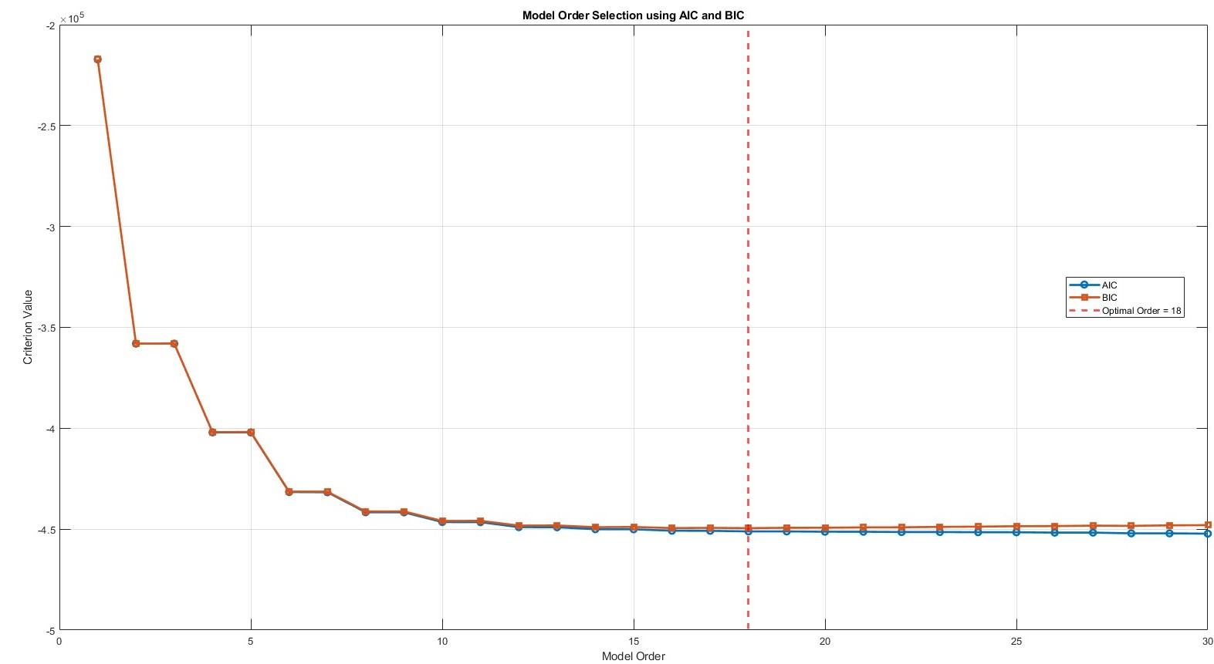
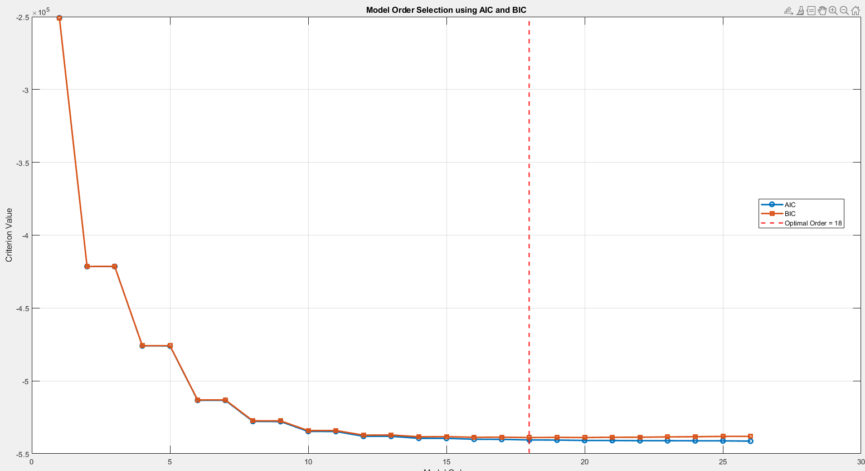
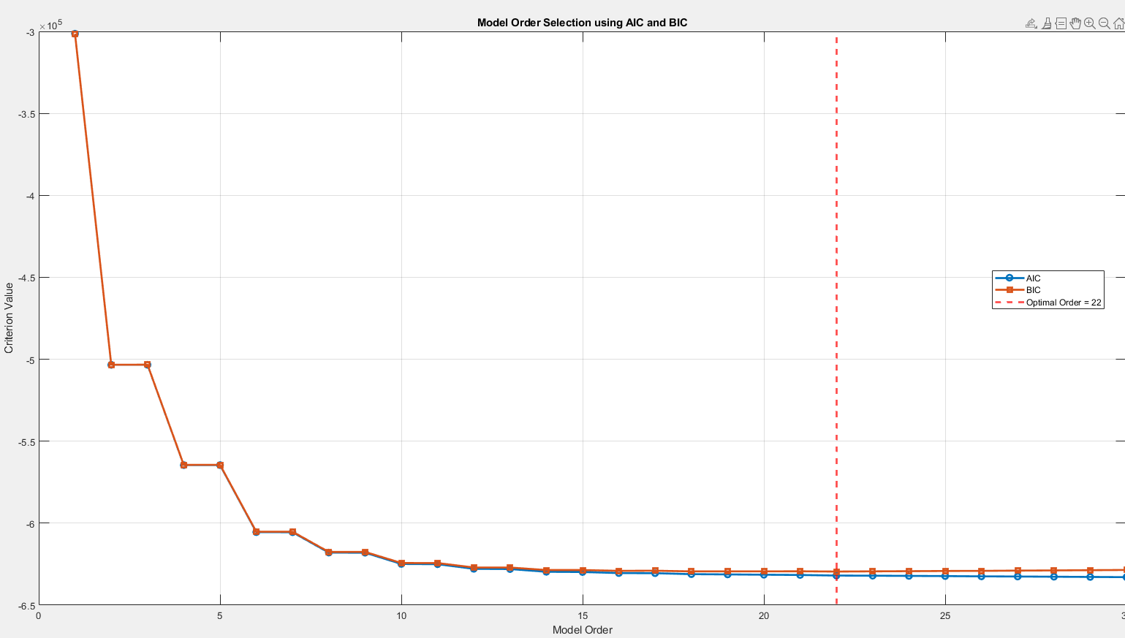
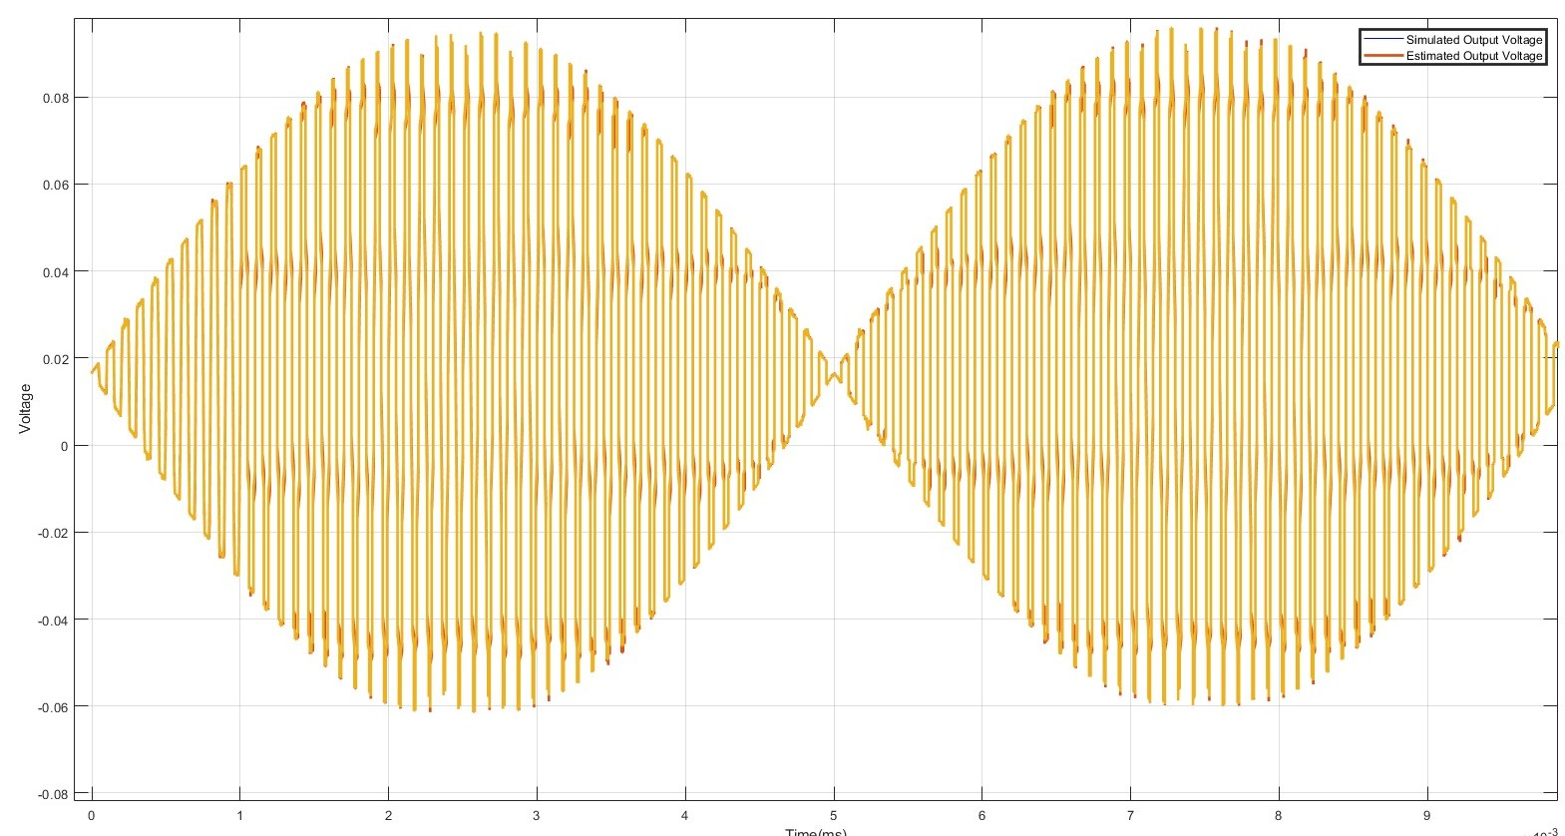
Illustration-3 : Analog Multiplier with sine input
Determination of optimal Order
Optimal order plot at Nmc=1000
Optimal order plot at Nmc=500
Optimal order plot at Nmc=2000
Simulated Output VS regression model Output

Slide 18
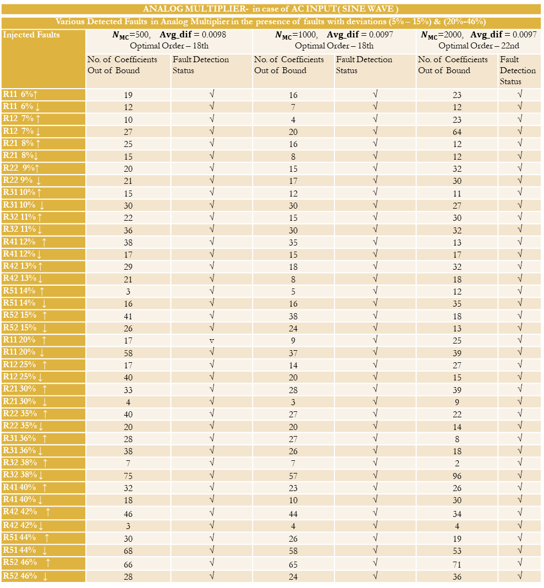
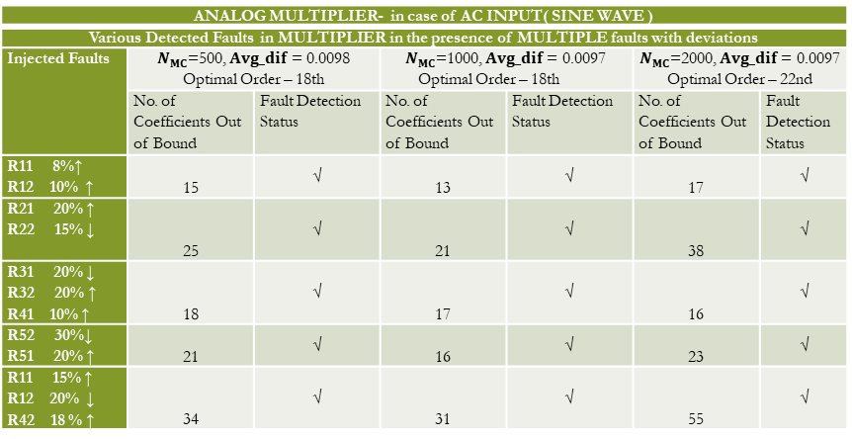
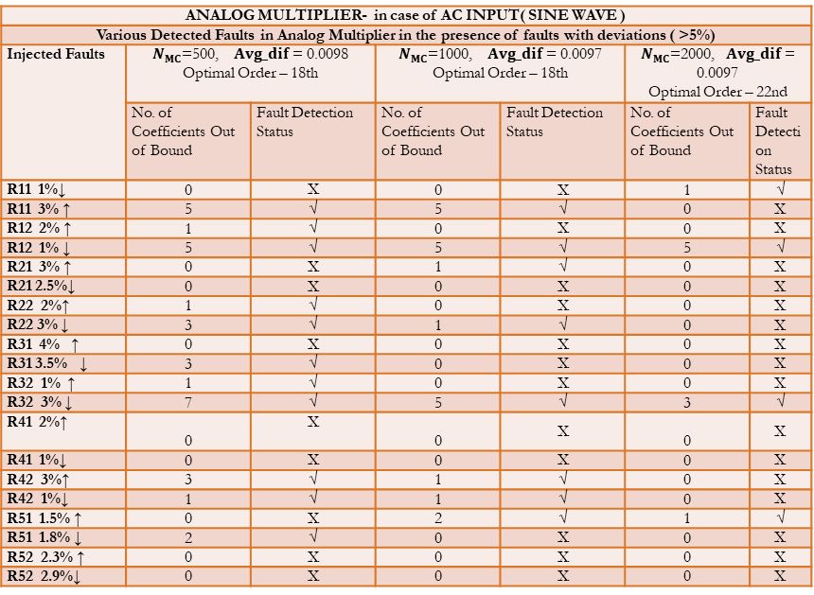
RESULT
ANALOG MULTIPLIER- in case of AC INPUT( SINE WAVE )
Various Detected Faults in Analog Multiplier in the presence of faults with deviations (5% – 15%) & (20%-46%)
Injected Faults | $N_{MC}$=500, $Avg_dif$ = 0.0098 Optimal Order – 18th |  | $N_{MC}$=1000, $Avg_dif$ = 0.0097 Optimal Order – 18th |  | $N_{MC}$=2000, $Avg_dif$ = 0.0097 Optimal Order – 22nd
 | No. of Coefficients Out of Bound | Fault Detection Status | No. of Coefficients Out of Bound | Fault Detection Status | No. of Coefficients Out of Bound | Fault Detection Status
R11 6%↑ | 19 | √ | 16 | √ | 23 | √
R11 6% ↓ | 12 | √ | 7 | √ | 12 | √
R12 7% ↑ | 10 | √ | 4 | √ | 23 | √
R12 7% ↓ | 27 | √ | 20 | √ | 64 | √
R21 8% ↑ | 25 | √ | 16 | √ | 12 | √
R21 8%↓ | 15 | √ | 8 | √ | 12 | √
R22 9%↑ | 20 | √ | 15 | √ | 32 | √
R22 9% ↓ | 21 | √ | 17 | √ | 30 | √
R31 10% ↑ | 15 | √ | 12 | √ | 11 | √
R31 10% ↓ | 30 | √ | 30 | √ | 27 | √
R32 11% ↑ | 22 | √ | 15 | √ | 30 | √
R32 11% ↓ | 36 | √ | 30 | √ | 32 | √
R41 12% ↑ | 38 | √ | 35 | √ | 13 | √
R41 12% ↓ | 17 | √ | 15 | √ | 17 | √
R42 13% ↑ | 29 | √ | 18 | √ | 32 | √
R42 13% ↓ | 21 | √ | 8 | √ | 18 | √
R51 14% ↑ | 3 | √ | 5 | √ | 12 | √
R51 14% ↓ | 16 | √ | 16 | √ | 35 | √
R52 15% ↑ | 41 | √ | 38 | √ | 18 | √
R52 15% ↓ | 26 | √ | 24 | √ | 13 | √
R11 20% ↑ | 17 | v | 9 | √ | 25 | √
R11 20% ↓ | 58 | √ | 37 | √ | 39 | √
R12 25% ↑ | 17 | √ | 14 | √ | 27 | √
R12 25% ↓ | 40 | √ | 20 | √ | 15 | √
R21 30% ↑ | 33 | √ | 28 | √ | 39 | √
R21 30% ↓ | 4 | √ | 3 | √ | 9 | √
R22 35% ↑ | 40 | √ | 27 | √ | 22 | √
R22 35% ↓ | 20 | √ | 20 | √ | 14 | √
R31 36% ↑ | 28 | √ | 27 | √ | 8 | √
R31 36% ↓ | 38 | √ | 26 | √ | 18 | √
R32 38% ↑ | 7 | √ | 7 | √ | 2 | √
R32 38% ↓ | 75 | √ | 57 | √ | 96 | √
R41 40% ↑ | 32 | √ | 23 | √ | 26 | √
R41 40% ↓ | 18 | √ | 10 | √ | 30 | √
R42 42% ↑ | 46 | √ | 44 | √ | 34 | √
R42 42% ↓ | 3 | √ | 4 | √ | 4 | √
R51 44% ↑ | 30 | √ | 26 | √ | 19 | √
R51 44% ↓ | 68 | √ | 58 | √ | 53 | √
R52 46% ↑ | 66 | √ | 65 | √ | 71 | √
R52 46% ↓ | 28 | √ | 24 | √ | 36 | √
ANALOG MULTIPLIER- in case of AC INPUT( SINE WAVE )
Various Detected Faults in Analog Multiplier in the presence of faults with deviations ( >5%)
Injected Faults | $N_{MC}$=500, $Avg_dif$ = 0.0098 Optimal Order – 18th |  | $N_{MC}$=1000, $Avg_dif$ = 0.0097 Optimal Order – 18th |  | $N_{MC}$=2000, $Avg_dif$ = 0.0097 Optimal Order – 22nd
 | No. of Coefficients Out of Bound | Fault Detection Status | No. of Coefficients Out of Bound | Fault Detection Status | No. of Coefficients Out of Bound | Fault Detection Status
R11 1%↓ | 0 | X | 0 | X | 1 | √
R11 3% ↑ | 5 | √ | 5 | √ | 0 | X
R12 2% ↑ | 1 | √ | 0 | X | 0 | X
R12 1% ↓ | 5 | √ | 5 | √ | 5 | √
R21 3% ↑ | 0 | X | 1 | √ | 0 | X
R21 2.5%↓ | 0 | X | 0 | X | 0 | X
R22 2%↑ | 1 | √ | 0 | X | 0 | X
R22 3% ↓ | 3 | √ | 1 | √ | 0 | X
R31 4% ↑ | 0 | X | 0 | X | 0 | X
R31 3.5% ↓ | 3 | √ | 0 | X | 0 | X
R32 1% ↑ | 1 | √ | 0 | X | 0 | X
R32 3% ↓ | 7 | √ | 5 | √ | 3 | √
R41 2%↑ | 0 | X | 0 | X | 0 | X
R41 1%↓ | 0 | X | 0 | X | 0 | X
R42 3%↑ | 3 | √ | 1 | √ | 0 | X
R42 1%↓ | 1 | √ | 1 | √ | 0 | X
R51 1.5% ↑ | 0 | X | 2 | √ | 1 | √
R51 1.8% ↓ | 2 | √ | 0 | X | 0 | X
R52 2.3% ↑ | 0 | X | 0 | X | 0 | X
R52 2.9%↓ | 0 | X | 0 | X | 0 | X
ANALOG MULTIPLIER- in case of AC INPUT( SINE WAVE )
Various Detected Faults in MULTIPLIER in the presence of MULTIPLE faults with deviations
Injected Faults | $N_{MC}$=500, $Avg_dif$ = 0.0098 Optimal Order – 18th |  | $N_{MC}$=1000, $Avg_dif$ = 0.0097 Optimal Order – 18th |  | $N_{MC}$=2000, $Avg_dif$ = 0.0097 Optimal Order – 22nd
 | No. of Coefficients Out of Bound | Fault Detection Status | No. of Coefficients Out of Bound | Fault Detection Status | No. of Coefficients Out of Bound | Fault Detection Status
R11 8%↑ R12 10% ↑ | 15 | √ | 13 | √ | 17 | √
R21 20% ↑ R22 15% ↓ | 25 | √ | 21 | √ | 38 | √
R31 20% ↓ R32 20% ↑ R41 10% ↑ | 18 | √ | 17 | √ | 16 | √
R52 30%↓ R51 20% ↑ | 21 | √ | 16 | √ | 23 | √
R11 15% ↑ R12 20% ↓ R42 18 % ↑ | 34 | √ | 31 | √ | 55 | √

Slide 19
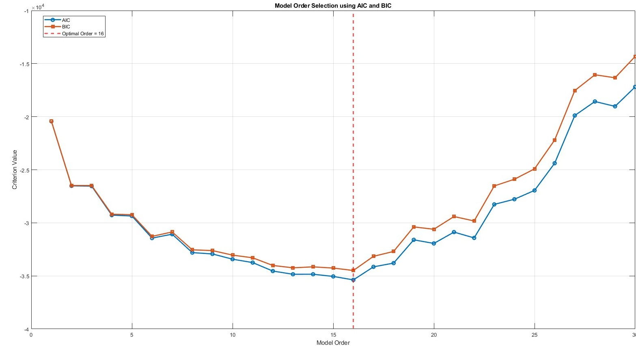
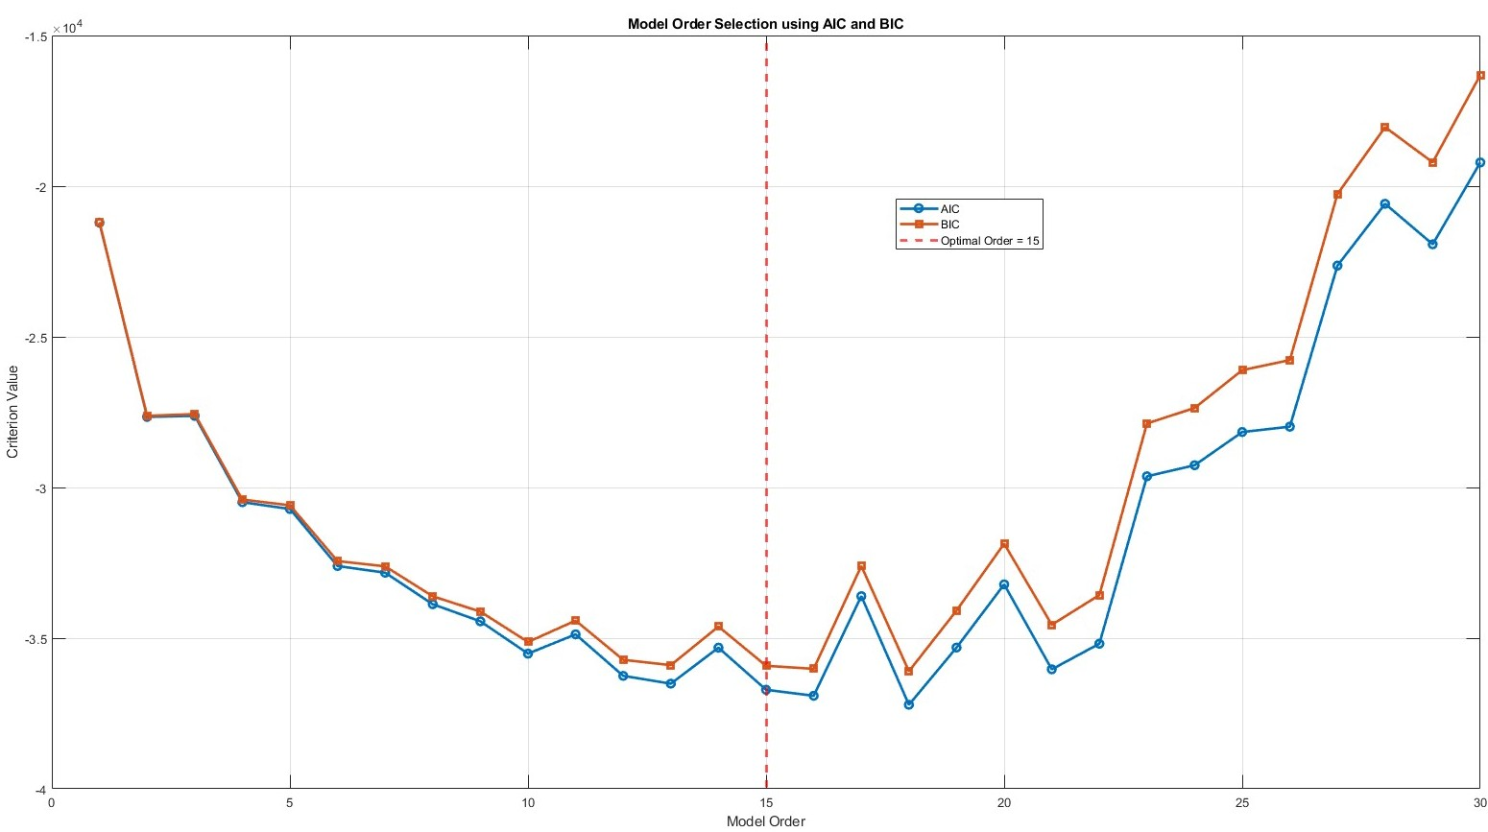
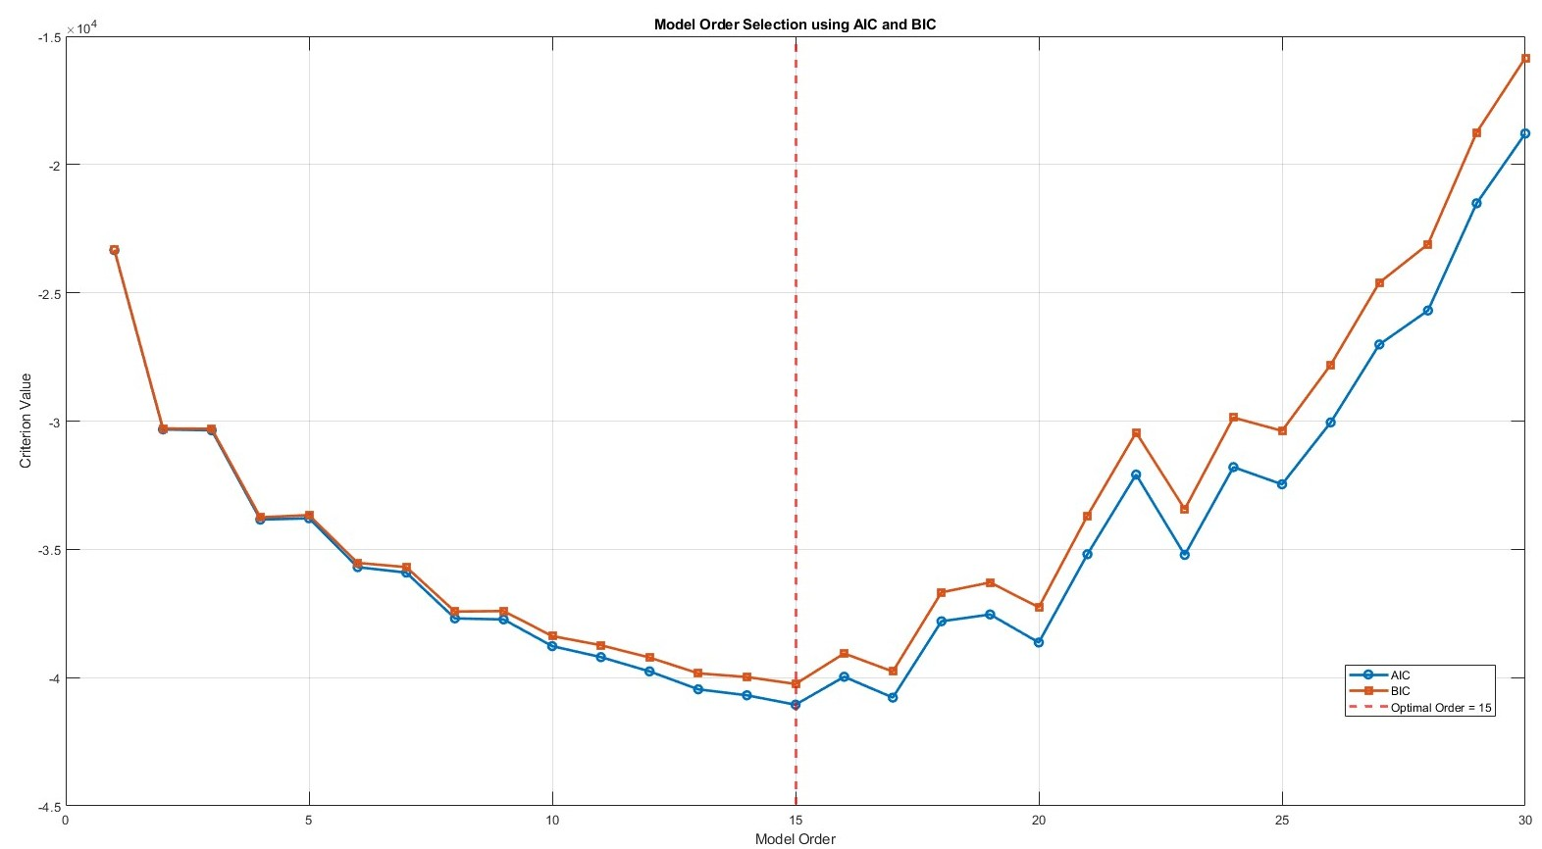
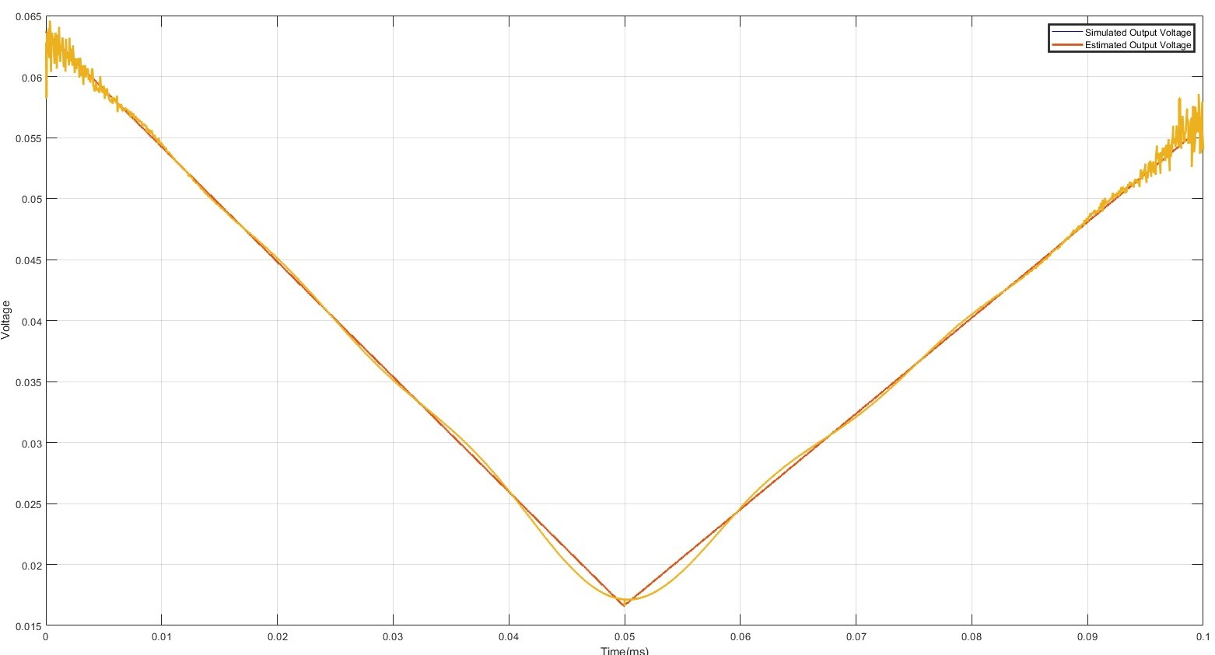
Illustration-4 : Analog Multiplier with DC sweep input
Determination of optimal Order
Optimal order plot at Nmc=1000
Optimal order plot at Nmc=2000
Optimal order plot at Nmc=500
Simulated Output VS regression model Output

Slide 20
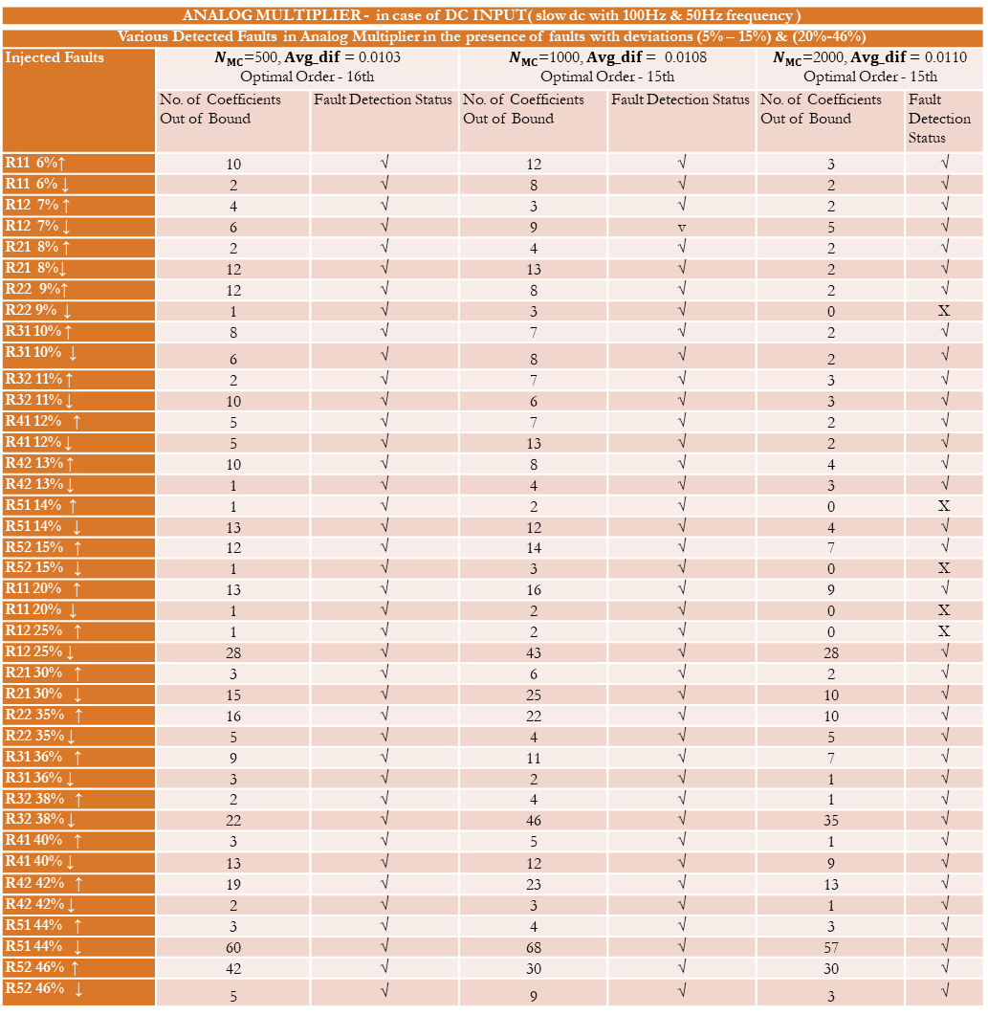
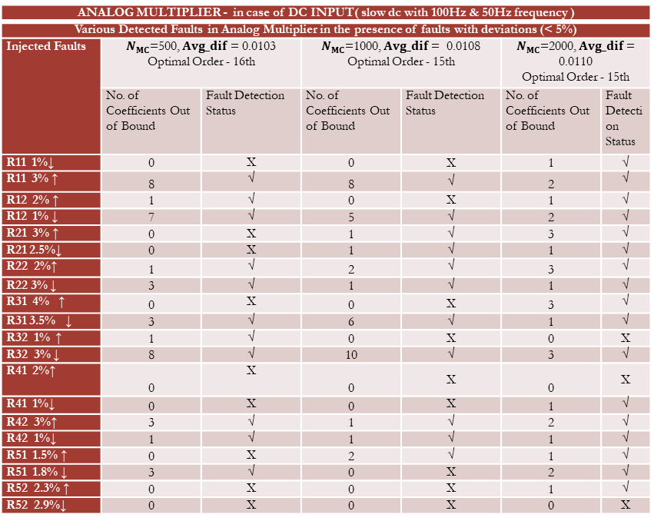
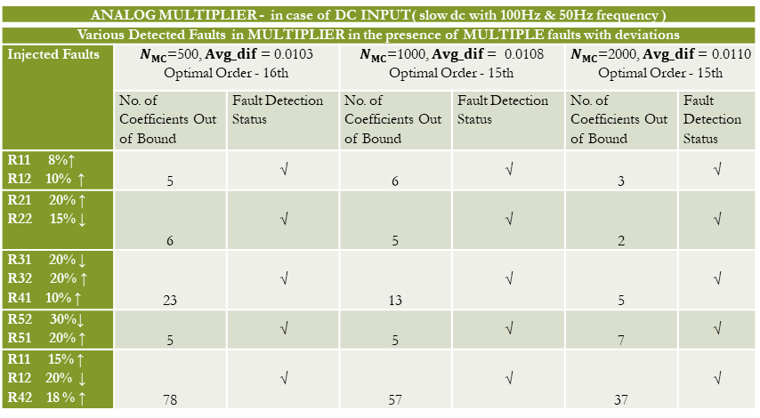
RESULT
ANALOG MULTIPLIER - in case of DC INPUT( slow dc with 100Hz & 50Hz frequency )
Various Detected Faults in Analog Multiplier in the presence of faults with deviations (5% – 15%) & (20%-46%)
Injected Faults | $N_{MC}$=500, $Avg_dif$ = 0.0103 Optimal Order - 16th |  | $N_{MC}$=1000, $Avg_dif$ = 0.0108 Optimal Order - 15th |  | $N_{MC}$=2000, $Avg_dif$ = 0.0110 Optimal Order - 15th
 | No. of Coefficients Out of Bound | Fault Detection Status | No. of Coefficients Out of Bound | Fault Detection Status | No. of Coefficients Out of Bound | Fault Detection Status
R11 6%↑ | 10 | √ | 12 | √ | 3 | √
R11 6% ↓ | 2 | √ | 8 | √ | 2 | √
R12 7% ↑ | 4 | √ | 3 | √ | 2 | √
R12 7% ↓ | 6 | √ | 9 | v | 5 | √
R21 8% ↑ | 2 | √ | 4 | √ | 2 | √
R21 8%↓ | 12 | √ | 13 | √ | 2 | √
R22 9%↑ | 12 | √ | 8 | √ | 2 | √
R22 9% ↓ | 1 | √ | 3 | √ | 0 | X
R31 10% ↑ | 8 | √ | 7 | √ | 2 | √
R31 10% ↓ | 6 | √ | 8 | √ | 2 | √
R32 11% ↑ | 2 | √ | 7 | √ | 3 | √
R32 11% ↓ | 10 | √ | 6 | √ | 3 | √
R41 12% ↑ | 5 | √ | 7 | √ | 2 | √
R41 12% ↓ | 5 | √ | 13 | √ | 2 | √
R42 13% ↑ | 10 | √ | 8 | √ | 4 | √
R42 13% ↓ | 1 | √ | 4 | √ | 3 | √
R51 14% ↑ | 1 | √ | 2 | √ | 0 | X
R51 14% ↓ | 13 | √ | 12 | √ | 4 | √
R52 15% ↑ | 12 | √ | 14 | √ | 7 | √
R52 15% ↓ | 1 | √ | 3 | √ | 0 | X
R11 20% ↑ | 13 | √ | 16 | √ | 9 | √
R11 20% ↓ | 1 | √ | 2 | √ | 0 | X
R12 25% ↑ | 1 | √ | 2 | √ | 0 | X
R12 25% ↓ | 28 | √ | 43 | √ | 28 | √
R21 30% ↑ | 3 | √ | 6 | √ | 2 | √
R21 30% ↓ | 15 | √ | 25 | √ | 10 | √
R22 35% ↑ | 16 | √ | 22 | √ | 10 | √
R22 35% ↓ | 5 | √ | 4 | √ | 5 | √
R31 36% ↑ | 9 | √ | 11 | √ | 7 | √
R31 36% ↓ | 3 | √ | 2 | √ | 1 | √
R32 38% ↑ | 2 | √ | 4 | √ | 1 | √
R32 38% ↓ | 22 | √ | 46 | √ | 35 | √
R41 40% ↑ | 3 | √ | 5 | √ | 1 | √
R41 40% ↓ | 13 | √ | 12 | √ | 9 | √
R42 42% ↑ | 19 | √ | 23 | √ | 13 | √
R42 42% ↓ | 2 | √ | 3 | √ | 1 | √
R51 44% ↑ | 3 | √ | 4 | √ | 3 | √
R51 44% ↓ | 60 | √ | 68 | √ | 57 | √
R52 46% ↑ | 42 | √ | 30 | √ | 30 | √
R52 46% ↓ | 5 | √ | 9 | √ | 3 | √
ANALOG MULTIPLIER - in case of DC INPUT( slow dc with 100Hz & 50Hz frequency )
Various Detected Faults in Analog Multiplier in the presence of faults with deviations (< 5%)
Injected Faults | $N_{MC}$=500, $Avg_dif$ = 0.0103 Optimal Order - 16th |  | $N_{MC}$=1000, $Avg_dif$ = 0.0108 Optimal Order - 15th |  | $N_{MC}$=2000, $Avg_dif$ = 0.0110 Optimal Order - 15th
 | No. of Coefficients Out of Bound | Fault Detection Status | No. of Coefficients Out of Bound | Fault Detection Status | No. of Coefficients Out of Bound | Fault Detection Status
R11 1%↓ | 0 | X | 0 | X | 1 | √
R11 3% ↑ | 8 | √ | 8 | √ | 2 | √
R12 2% ↑ | 1 | √ | 0 | X | 1 | √
R12 1% ↓ | 7 | √ | 5 | √ | 2 | √
R21 3% ↑ | 0 | X | 1 | √ | 3 | √
R21 2.5%↓ | 0 | X | 1 | √ | 1 | √
R22 2%↑ | 1 | √ | 2 | √ | 3 | √
R22 3% ↓ | 3 | √ | 1 | √ | 1 | √
R31 4% ↑ | 0 | X | 0 | X | 3 | √
R31 3.5% ↓ | 3 | √ | 6 | √ | 1 | √
R32 1% ↑ | 1 | √ | 0 | X | 0 | X
R32 3% ↓ | 8 | √ | 10 | √ | 3 | √
R41 2%↑ | 0 | X | 0 | X | 0 | X
R41 1%↓ | 0 | X | 0 | X | 1 | √
R42 3%↑ | 3 | √ | 1 | √ | 2 | √
R42 1%↓ | 1 | √ | 1 | √ | 1 | √
R51 1.5% ↑ | 0 | X | 2 | √ | 1 | √
R51 1.8% ↓ | 3 | √ | 0 | X | 2 | √
R52 2.3% ↑ | 0 | X | 0 | X | 1 | √
R52 2.9%↓ | 0 | X | 0 | X | 0 | X
ANALOG MULTIPLIER - in case of DC INPUT( slow dc with 100Hz & 50Hz frequency )
Various Detected Faults in MULTIPLIER in the presence of MULTIPLE faults with deviations
Injected Faults | $N_{MC}$=500, $Avg_dif$ = 0.0103 Optimal Order - 16th |  | $N_{MC}$=1000, $Avg_dif$ = 0.0108 Optimal Order - 15th |  | $N_{MC}$=2000, $Avg_dif$ = 0.0110 Optimal Order - 15th
 | No. of Coefficients Out of Bound | Fault Detection Status | No. of Coefficients Out of Bound | Fault Detection Status | No. of Coefficients Out of Bound | Fault Detection Status
R11 8%↑ R12 10% ↑ | 5 | √ | 6 | √ | 3 | √
R21 20% ↑ R22 15% ↓ | 6 | √ | 5 | √ | 2 | √
R31 20% ↓ R32 20% ↑ R41 10% ↑ | 23 | √ | 13 | √ | 5 | √
R52 30%↓ R51 20% ↑ | 5 | √ | 5 | √ | 7 | √
R11 15% ↑ R12 20% ↓ R42 18 % ↑ | 78 | √ | 57 | √ | 37 | √

Slide 21
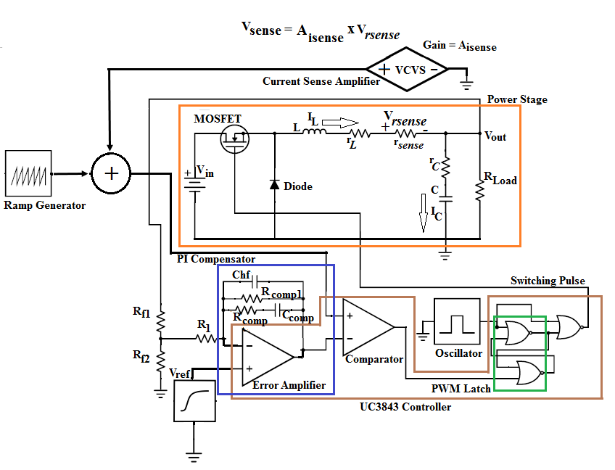
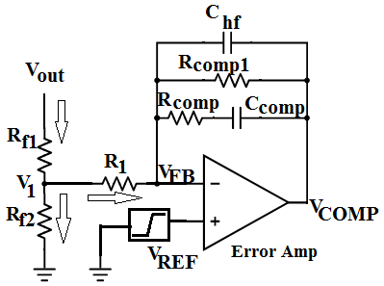
Case Study-3: PI Compensator of a Buck Converter
It is the peak current-mode controlled DC-DC Buck converter using PWM control IC UC3843.
A key functional block of this controller is the PI compensator (shown in Fig. ), which is built using an error amplifier.
The output voltage (Vout) is divided by the resistor dividetr network (Rf1 and Rf2) and then fed to the error amplifier
Fig.. Schematic of a current programmed control buck converter
The controller is crucial to maintain a constant output voltage.
Therefore, the controller circuit must be properly designed and tested.
In this study, we focus on parametric fault detection in the controller part of the Buck converter circuit.
The nominal values are:-R_{f1}=9.76 kΩ, R_{f2}=3.25 kΩ, R₁=1kΩ, C_{hf}=30pF, C_{comp}=2nF, R_{comp1} =10 MΩ, R_{comp}=80 kΩ
Fig.. PWM controller circuit of buck converter

Slide 22
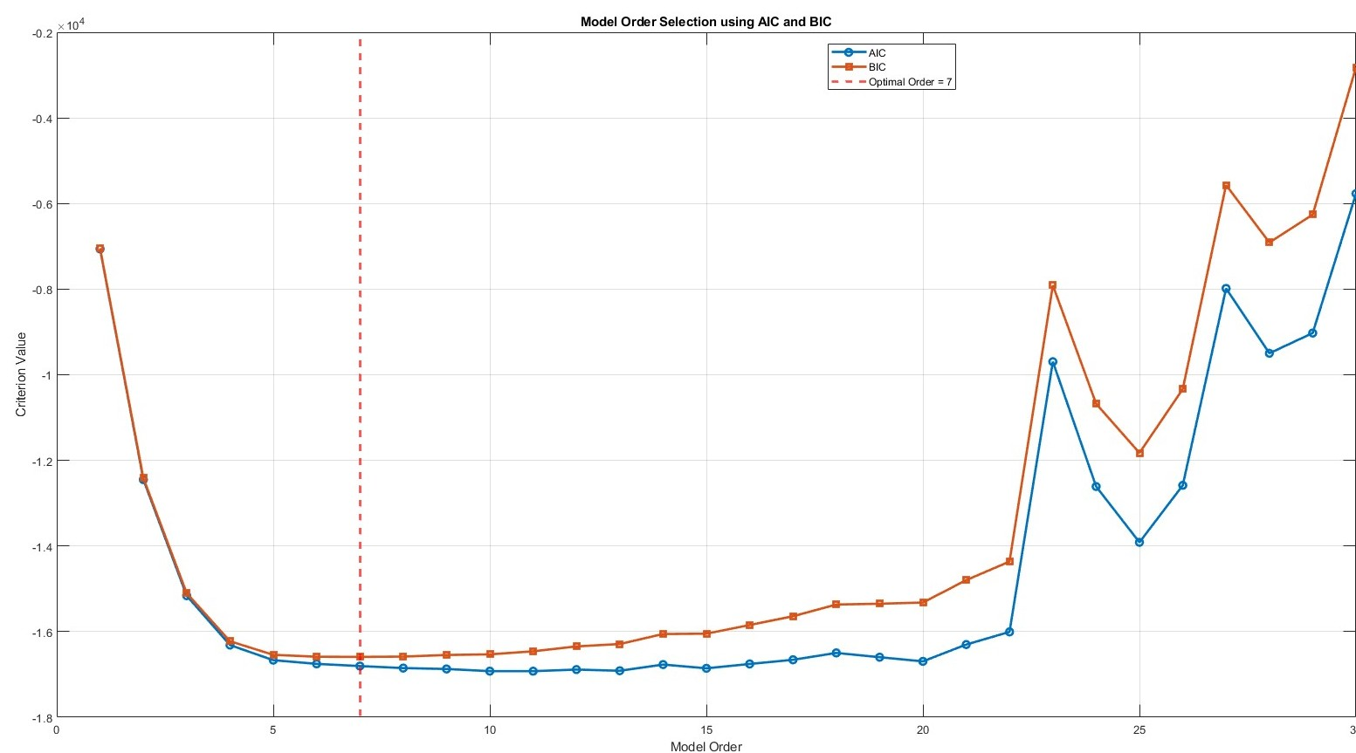
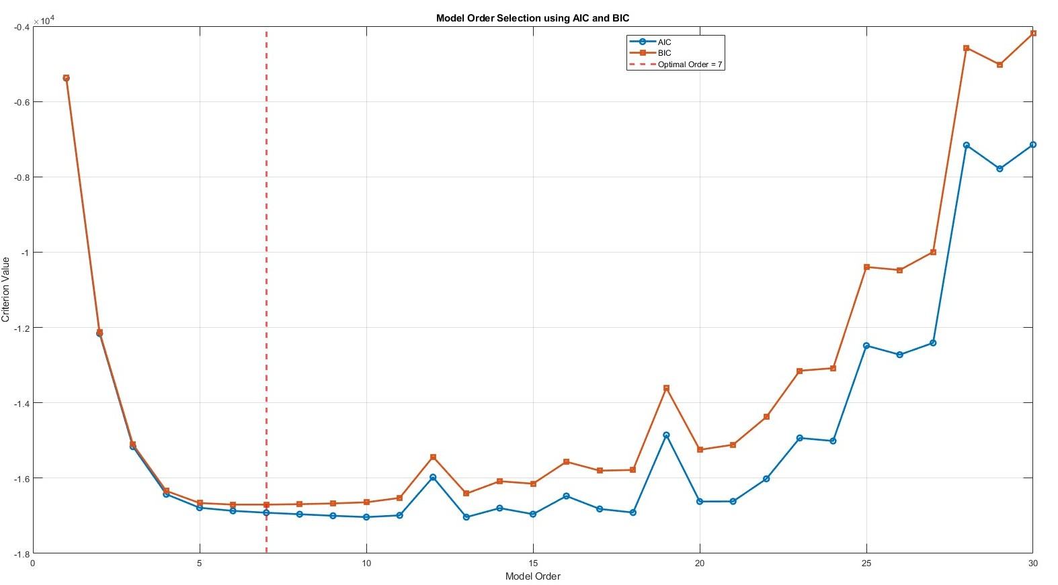
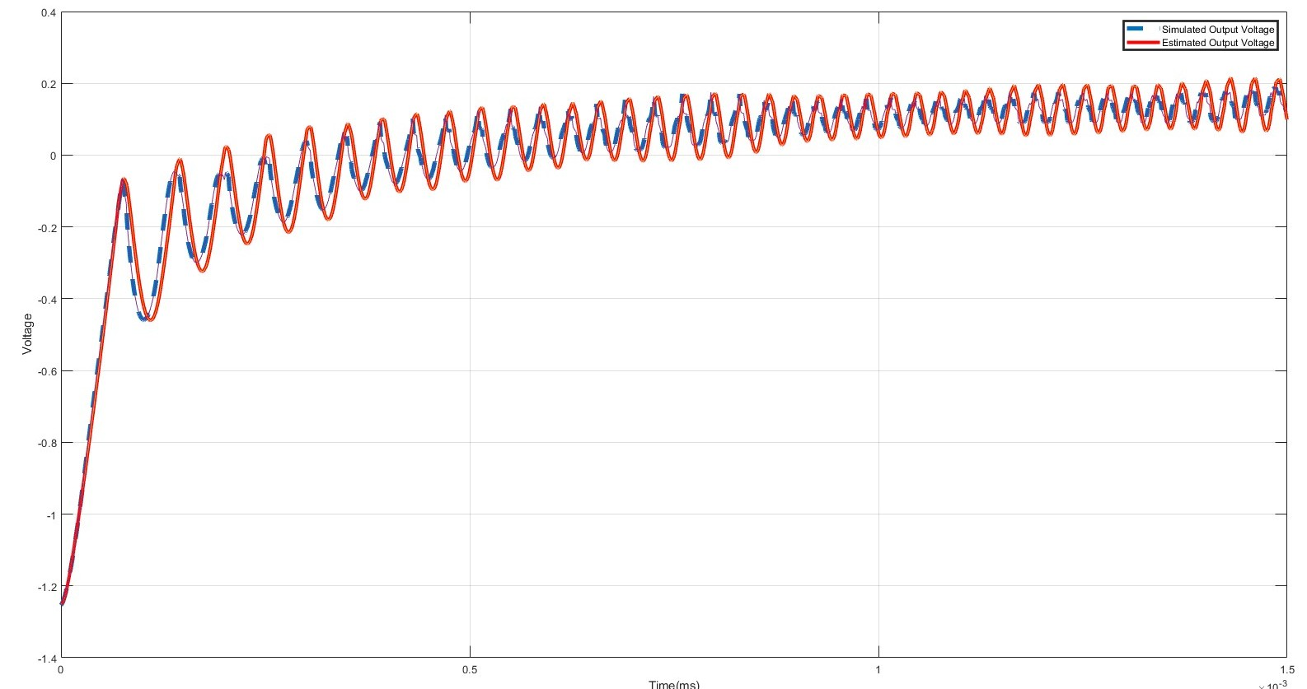
Illustration-5 : PI Compensator of a Buck Converter
Determination of optimal Order
Optimal order plot at Nmc=500
Optimal order plot at Nmc=1000
Simulated Output VS regression model Output

Slide 23
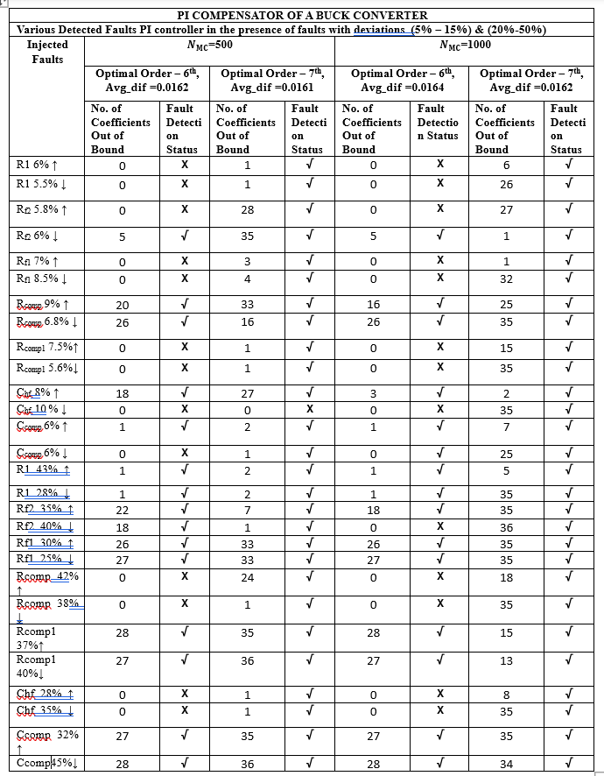
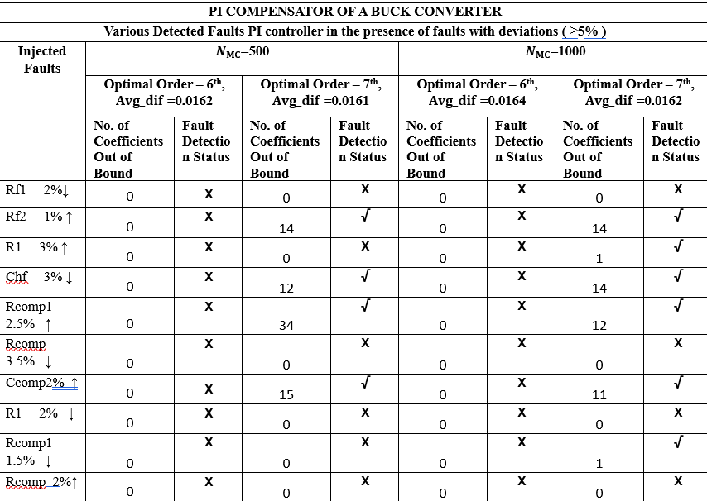
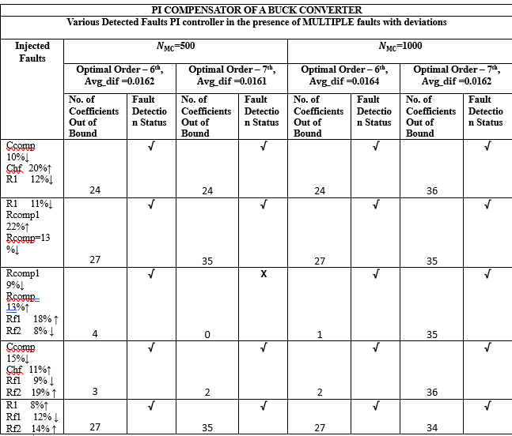
RESULT

Slide 24

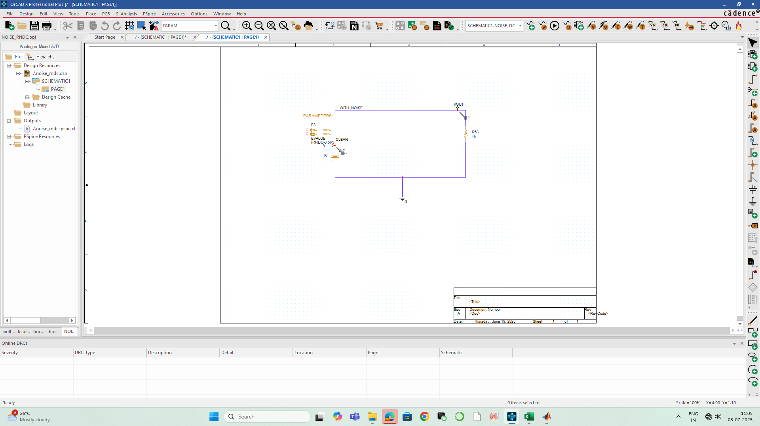

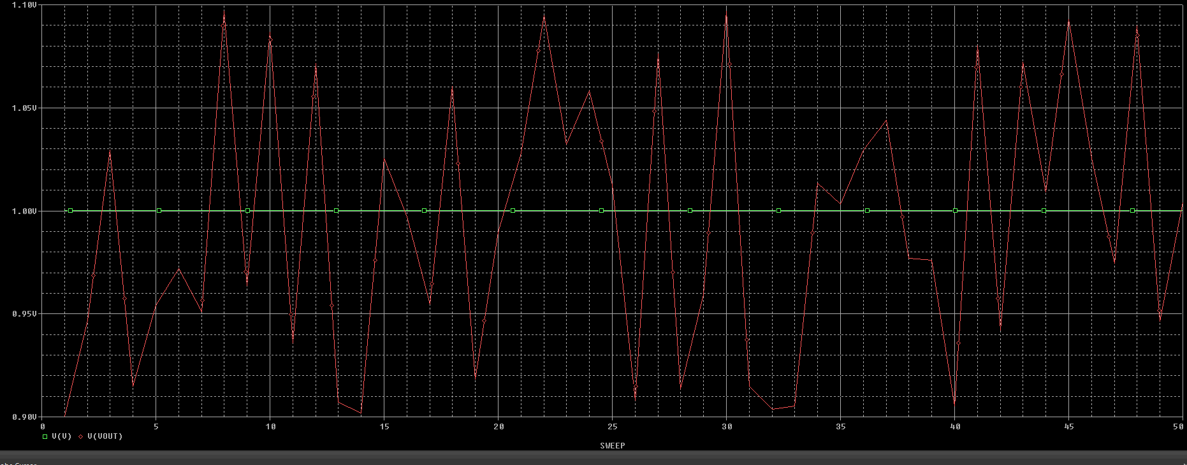
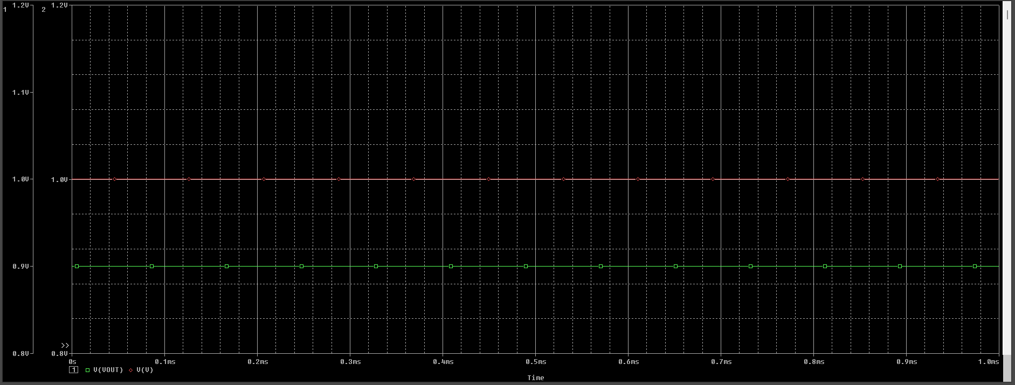
NOISE ANALYSIS
🔷 Why Simulate Noise?
Real-world circuits are affected by transient and steady-state noise.
Noise impacts behavior, performance, and fault detectability.
Simulating noise improves test robustness.
🔶 Noise Simulation Techniques
1. Random Noise Source
Add a voltage/current source with a defined DC value and noise amplitude.
Simulates real-time fluctuations at each time step.
Example: 1V ± 0.2V generates a range from 0.9V to 1.1V.
2. RNDR Function (Transient/DC Analysis)
Injects a constant random value for the full simulation.
Example: (RNDR - 0.5)/5 → adds ±0.1V random offset.
3. RNDC Function (Sweeps/Monte Carlo)
Generates different random values per sweep.
Useful for Monte Carlo, DC Sweep, Temperature Analysis.

Slide 25
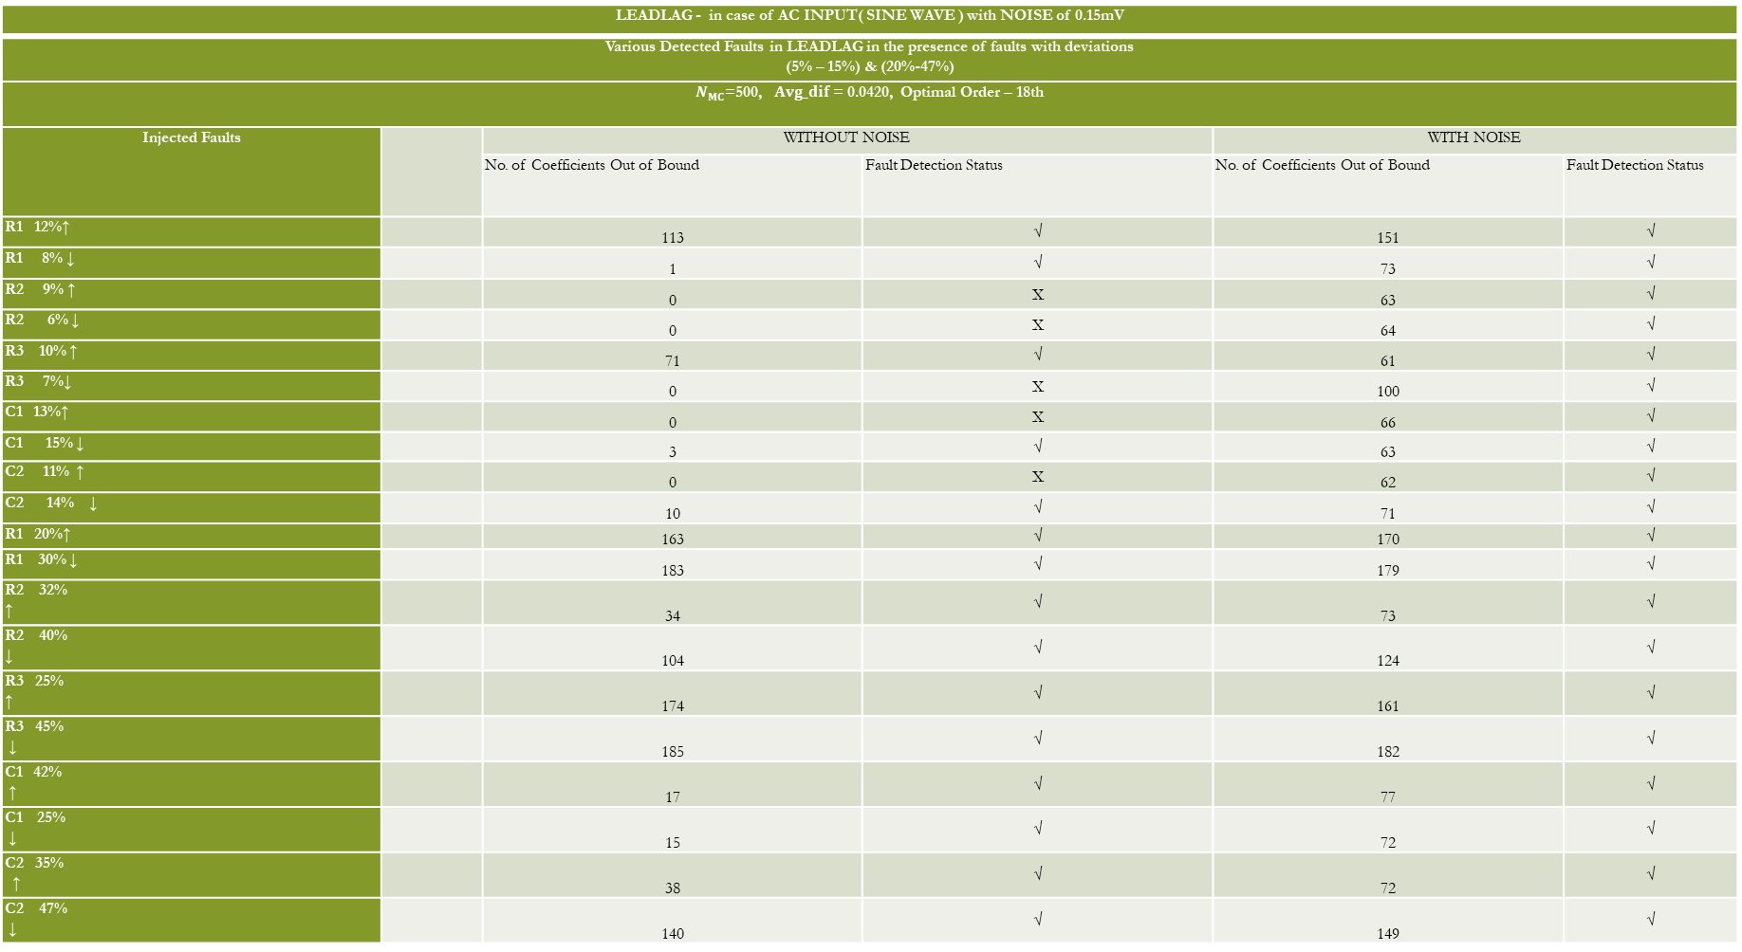
COMPARISON
LEADLAG - in case of AC INPUT( SINE WAVE ) with NOISE of 0.15mV
Various Detected Faults in LEADLAG in the presence of faults with deviations (5% – 15%) & (20%-47%)
$N_{MC}$=500, $Avg_dif$ = 0.0420, Optimal Order – 18th
Injected Faults |  | WITHOUT NOISE |  | WITH NOISE
 |  | No. of Coefficients Out of Bound | Fault Detection Status | No. of Coefficients Out of Bound | Fault Detection Status
R1 12%↑ |  | 113 | √ | 151 | √
R1 8% ↓ |  | 1 | √ | 73 | √
R2 9% ↑ |  | 0 | X | 63 | √
R2 6% ↓ |  | 0 | X | 64 | √
R3 10% ↑ |  | 71 | √ | 61 | √
R3 7%↓ |  | 0 | X | 100 | √
C1 13%↑ |  | 0 | X | 66 | √
C1 15% ↓ |  | 3 | √ | 63 | √
C2 11% ↑ |  | 0 | X | 62 | √
C2 14% ↓ |  | 10 | √ | 71 | √
R1 20%↑ |  | 163 | √ | 170 | √
R1 30% ↓ |  | 183 | √ | 179 | √
R2 32% ↑ |  | 34 | √ | 73 | √
R2 40% ↓ |  | 104 | √ | 124 | √
R3 25% ↑ |  | 174 | √ | 161 | √
R3 45% ↓ |  | 185 | √ | 182 | √
C1 42% ↑ |  | 17 | √ | 77 | √
C1 25% ↓ |  | 15 | √ | 72 | √
C2 35% ↑ |  | 38 | √ | 72 | √
C2 47% ↓ |  | 140 | √ | 149 | √

Slide 26


CONCLUSION
Polynomial regression is effective for analog fault testing across both linear and non-linear circuits.
Fault detection is accurate for:
Single faults: Detected reliably at deviations > ±5% (within expected design tolerances).
Multiple faults: Also successfully detected when two or more components deviate beyond tolerance.
For deviations ≤ ±5%, faults are not flagged, as this lies within the allowable tolerance margin set during Monte Carlo construction.
Higher polynomial orders improve detection capability but may introduce complexity or overfitting.
Noise Robustness:
Verified using RNDR/RNDC noise sources in OrCAD PSpice.
Compared coefficients under noisy and clean conditions.

Slide 27
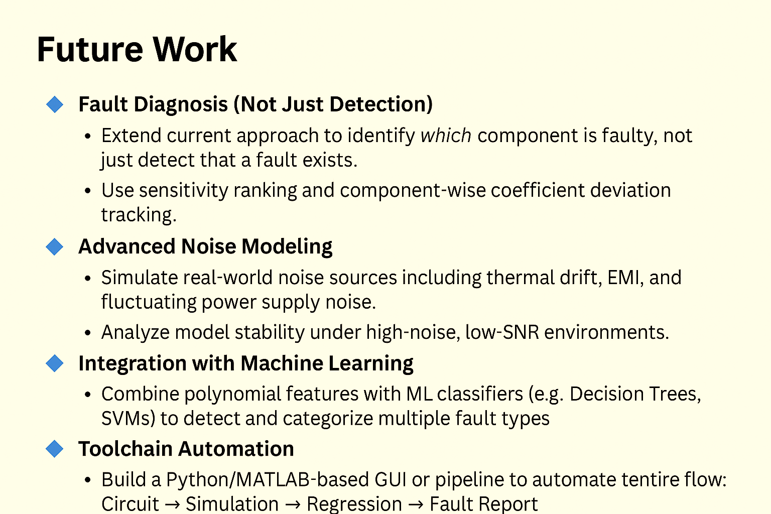

Slide 28
References
[1] S. Sindia, V. D. Agrawal and V. Singh, "Non-linear analog circuit test and diagnosis under process variation using V-Transform coefficients," 29th VLSI Test Symposium, Dana Point, CA, USA, 2011, pp. 64-69, doi: 10.1109/VTS.2011.5783756.
[2] S. Sindia and V. D. Agrawal, "High sensitivity test signatures for unconventional analog circuit test paradigms," 2013 IEEE International Test Conference (ITC), Anaheim, CA, USA, 2013, pp. 1-10, doi: 10.1109/TEST.2013.6651884.
[3] P. Bilski, "Analysis of the Ensemble of Regression Algorithms for the Analog Circuit Parametric Identification," Measurement, vol. 160, 2020, Art. no. 107829, doi: 10.1016/j.measurement.2020.107829.
[4] Zhao, Dongsheng, and Yuzhu He. "A new test point selection method for analog circuit." Journal of Electronic Testing 31 (2015): 53-66.
[5] A. A. Hatzopoulos, "Analog circuit testing," 2017 International Mixed Signals Testing Workshop (IMSTW), Thessaloniki, Greece, 2017, pp. 1-6, doi: 10.1109/IMS3TW.2017.7995206.
[6] H. Kobayashi et al., "Analog/Mixed-Signal Circuit Testing Technologies in IoT Era," 2020 IEEE 15th International Conference on Solid-State & Integrated Circuit Technology (ICSICT), Kunming, China, 2020, pp. 1-4, doi: 10.1109/ICSICT49897.2020.9278194.
[7] Sindia S, Agrawal VD, Singh V (2012) Parametric Fault Testing of Non-Linear Analog Circuits Based on Polynomial and V-Transform Coefficients. J Electron Test 28:757–771. https://doi.org/10.1007/s10836-012-5326-z
[8] V. Riewruja and A. Rerkratn, "Four-quadrant analogue multiplier using operational amplifier," International Journal of Electronics, vol. 98, no. 4, pp. 459–474, 2011, doi: 10.1080/00207217.2010.520155.

Slide 29


